Slide 1

Welcome to Year 4!
Meeting for Parents

Slide 2
Curriculum Overview
Topic themes for the year:
  Victorious Victorians
  Rotten Romans
  Water, Water Everywhere

Slide 3
Mastery in English:
Comprehension & Inference
For comprehension in Year 4, as well as finding answers within the text, there will be a lot of inference questions. This is where the children will have to use the information they know and also their own experiences to be able to answer the questions – the answers will not always be written in the text.
Some questions will require the children to write more than one point to explain their answer, or they will need to provide information from the text to help explain their answer.

Slide 4
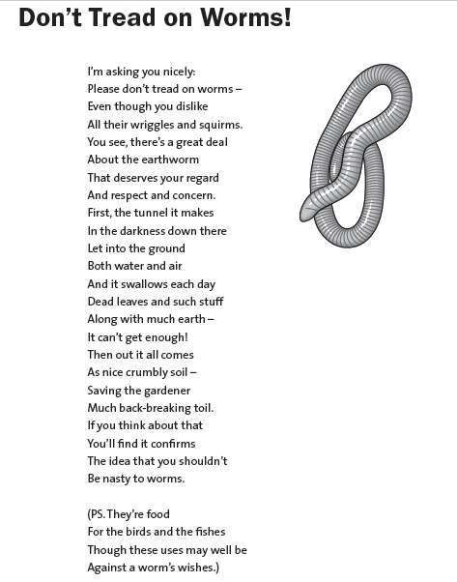
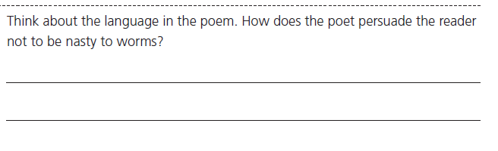
Mastery in English:
Comprehension & Inference

Slide 5
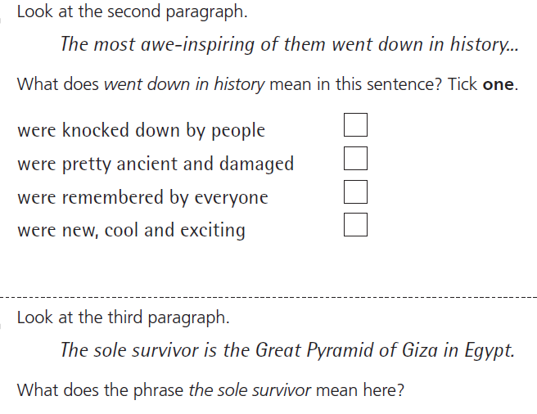
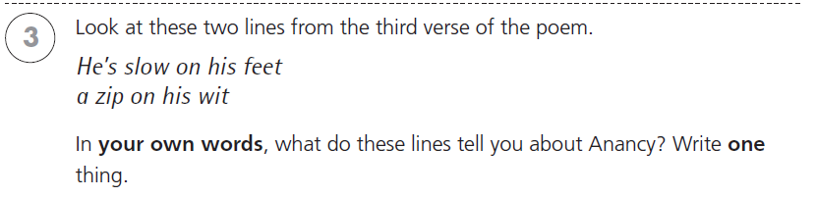
Mastery in English:
Comprehension & Inference

Slide 6
Mastery in Maths:
Problem Solving
Problem solving questions will often involve more than one step and might require more than one different Maths skill to answer. The children will learn how to pick out all the relevant information from the question and which part of the question to solve first. They will also learn how to logically find all answers to a question.
Reasoning questions will require children to explain their answers, using the relevant mathematical language.

Slide 7
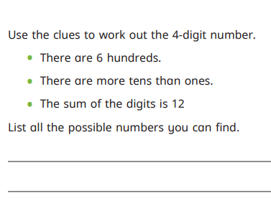
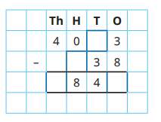
Mastery in Maths:
Problem Solving

Slide 8
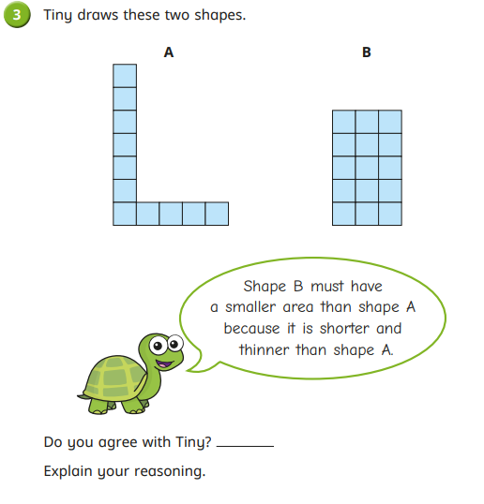
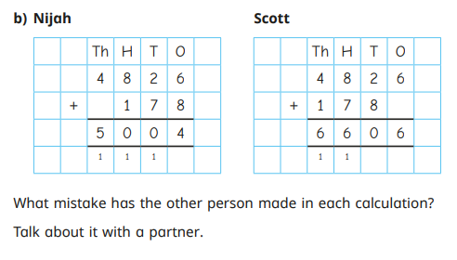
Mastery in Maths:
Reasoning

Slide 9
Times Tables & Spelling
Times Tables
The children will learn the remaining times tables in Year 4, as well as the related division facts. There will be a weekly times tables test which will test the children’s multiplication and division knowledge for these times tables, as well as testing their speed and accuracy in answering times tables questions as their knowledge becomes more secure.
Spellings
The children will continue to have a different spelling pattern to learn each week with a weekly spellings test. There will be a mixed test at the end of each half term to ensure the children can recall the spellings they have learnt from the previous weeks.

Slide 10
Times Tables Check
  Summer term
  25 questions
  6 seconds
  Computerised

Slide 11
Expectations
Uniform – Children should come to school in full school uniform each day with long hair tied up. Shoes should have a strap or laces, no slip on shoes or pumps. Please ensure hair accessories are suitable for school.
Homework – Maths and English homework should be completed weekly. New Maths and English will be available on Fridays to be completed by the following Tuesday. There will be new challenge homework each half term, with children aiming to complete at least 30points. Children who do not complete homework at home will be given time during a lunchtime to complete it.
Reading Books/ Contact books – Reading and contact books should be in school each day. Contact books will be checked every Monday and children will be heard read by an adult regularly in school. Please write in and sign to indicate when your child has read. Children should be reading to an adult at least 3 times a week.
P.E. Kit – PE days will be Tuesdays and Wednesdays for the Autumn term, but as this can change at short notice, please make sure PE kits are in school all week. At present, all PE lessons will be outside. Children will therefore need trainers, and a tracksuit/jogging bottoms/jumper is recommended. Girls will need a spare pair of socks in the winter if they are wearing tights to school. Earrings will need to be removed for all PE lessons. Please could all PE kit be named.
Water bottles – Please ensure your child has a water bottle in school every day. Water bottles will be sent home with the children at the end of each day.

Slide 12
Assessment Targets
Working Towards the expected standard
Working At the expected standard
Working Above the expected standard

Slide 13
School Trips & Concerts
Trips and workshops – tbc
Christmas concert – 7th December
Bowles – 7th – 9th February 2024

Slide 14
Our Challenge Values
Co-operation
Perseverance
Independence
Creativity
Motivation
Aspiration

Slide 15

Class Dojo

Slide 16
Thank you for reading Year 4’s ‘Welcome to the Year Group’ meeting. We hope you found it useful. Please contact me if you have any questions.

