Slide 1

Welcome to Year 1!
Meeting for Parents

Slide 2
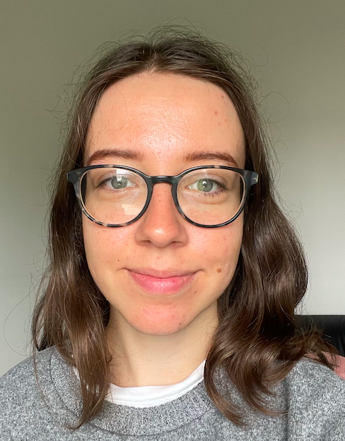
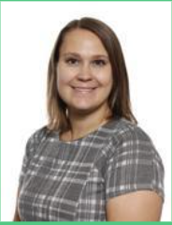
Our Year One Team
Miss Williams |  | Class teacher
Mrs Andrews Ms Neha |  | Teaching Assistants
Mrs Rope |  | PPA and ECT cover teacher- Tuesday

Slide 3
Reading Records
 | Reading records have now been handed out to your children. Please aim to read with your children everyday. Reading books will be changed every Friday. Children should read through their books twice. If you have done this before Friday there are tricky words that children can practice reading and writing on the class page. If you or the Year1 team believe it would be beneficial to read their book for a third time please write this in their reading record.

Slide 4
Our School Day
We are making the transition from Reception to Year 1 as smooth as possible.
We have continuous provision running throughout this term and although this will reduce over time it will continue throughout much of the year to enable your children to develop in all areas.
We provide resources to support fine and gross motor skills, which lead into pencil control and application of phonics and knowledge of tricky words. We also have maths activities and construction games as well as activities to support language in our topic areas.

Slide 5
Curriculum Overview
Creative Curriculum themes for the year:
The World and Me
Magical Toys
Explorers
Explorers
Let’s Get Growing
Oh I do Like To Be Beside The Seaside!

Slide 6
Phonics/Reading Skills
All Year 1 children undertake a phonics screening check during the summer term.
This year, this will take place in the week beginning Monday 10th June 2024.
There are plenty of resources that you can access on the Year 1 class page that will help your child to prepare for the screening. Reading frequently with your child is also great practice.

Slide 7
Mastery in English: (e.g. of comprehension/inference question)
Good open-ended questions are the key to success in reading comprehension.
Are you puzzled by anything, if so, what?
Why do you think the character said/did that?
Does it remind you of anything that has happened to you?
Does it remind you of anything you have read/seen in a film/on TV/a play?
Ask questions which precede/follow the text e.g
Where do you think the bear will go at the end of ‘We’re Going On A Bear Hunt’?

Slide 8
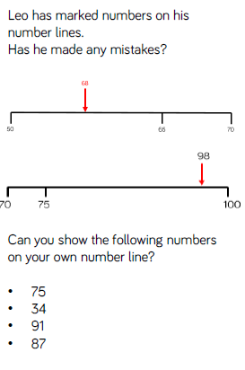
Mastery in Maths: (e.g. of problem solving activity)
Once your child has practised the skill of counting, then they will learn to problem solve using that specific skill.
And the same in all areas of Maths.

Slide 9
How can you help?
Homework completed (which will begin after October half term) and email to teacher if too difficult, and problem solve using the skills if too easy.
Reading Contact books – please record page numbers and if they understood what they read.
P.E. Kit – Earring Policy
Correct uniform
Other learning – riding a bike, cooking, independence etc.

Slide 10
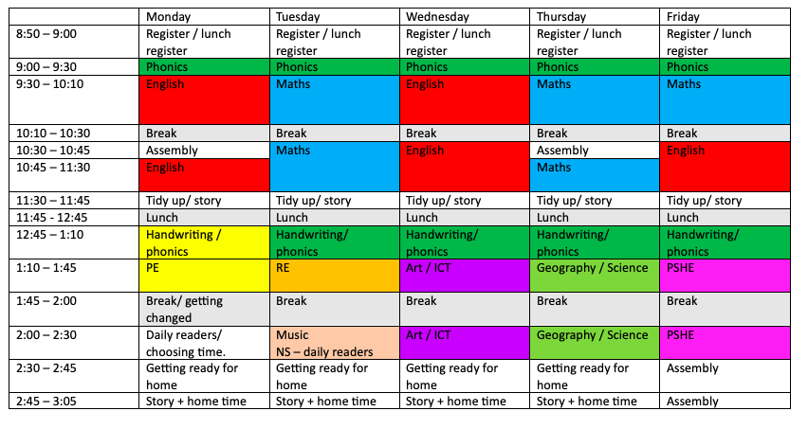
Class timetable

Slide 11
I look forward to getting to know you and your children this year. Please contact me if you have any queries throughout the year:
year1@crockenhill.kent.sch.uk
or on the class Dojo page.

