Slide 1
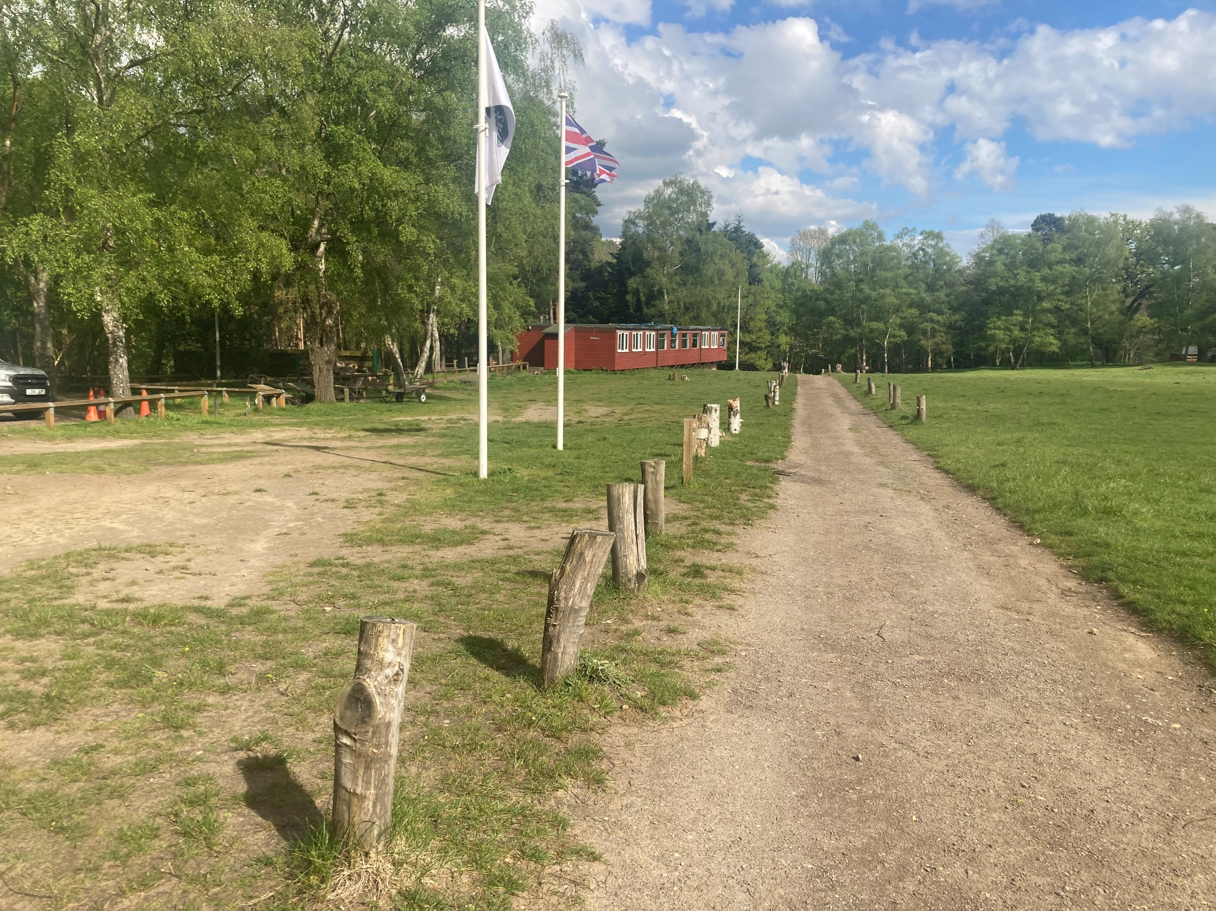
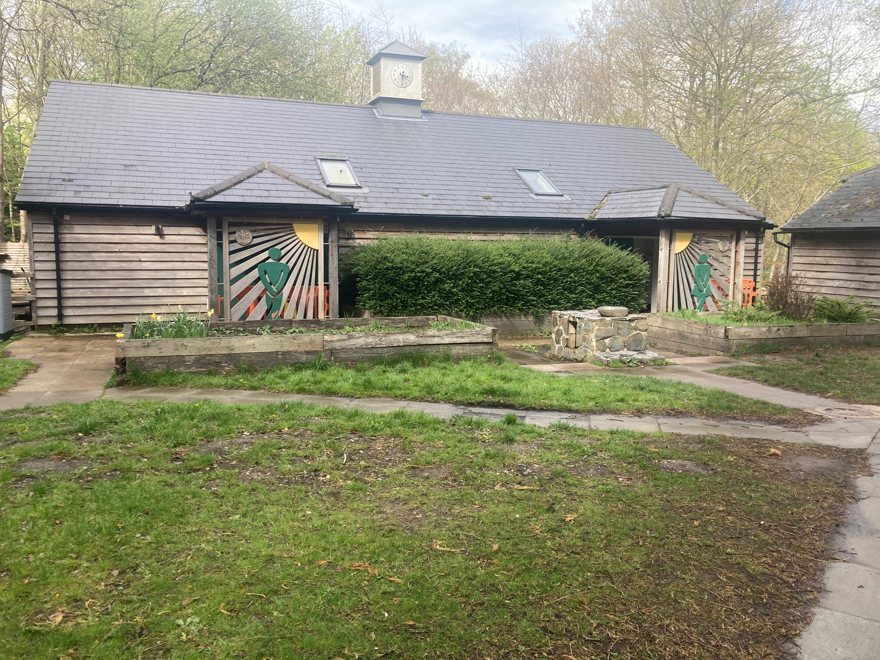
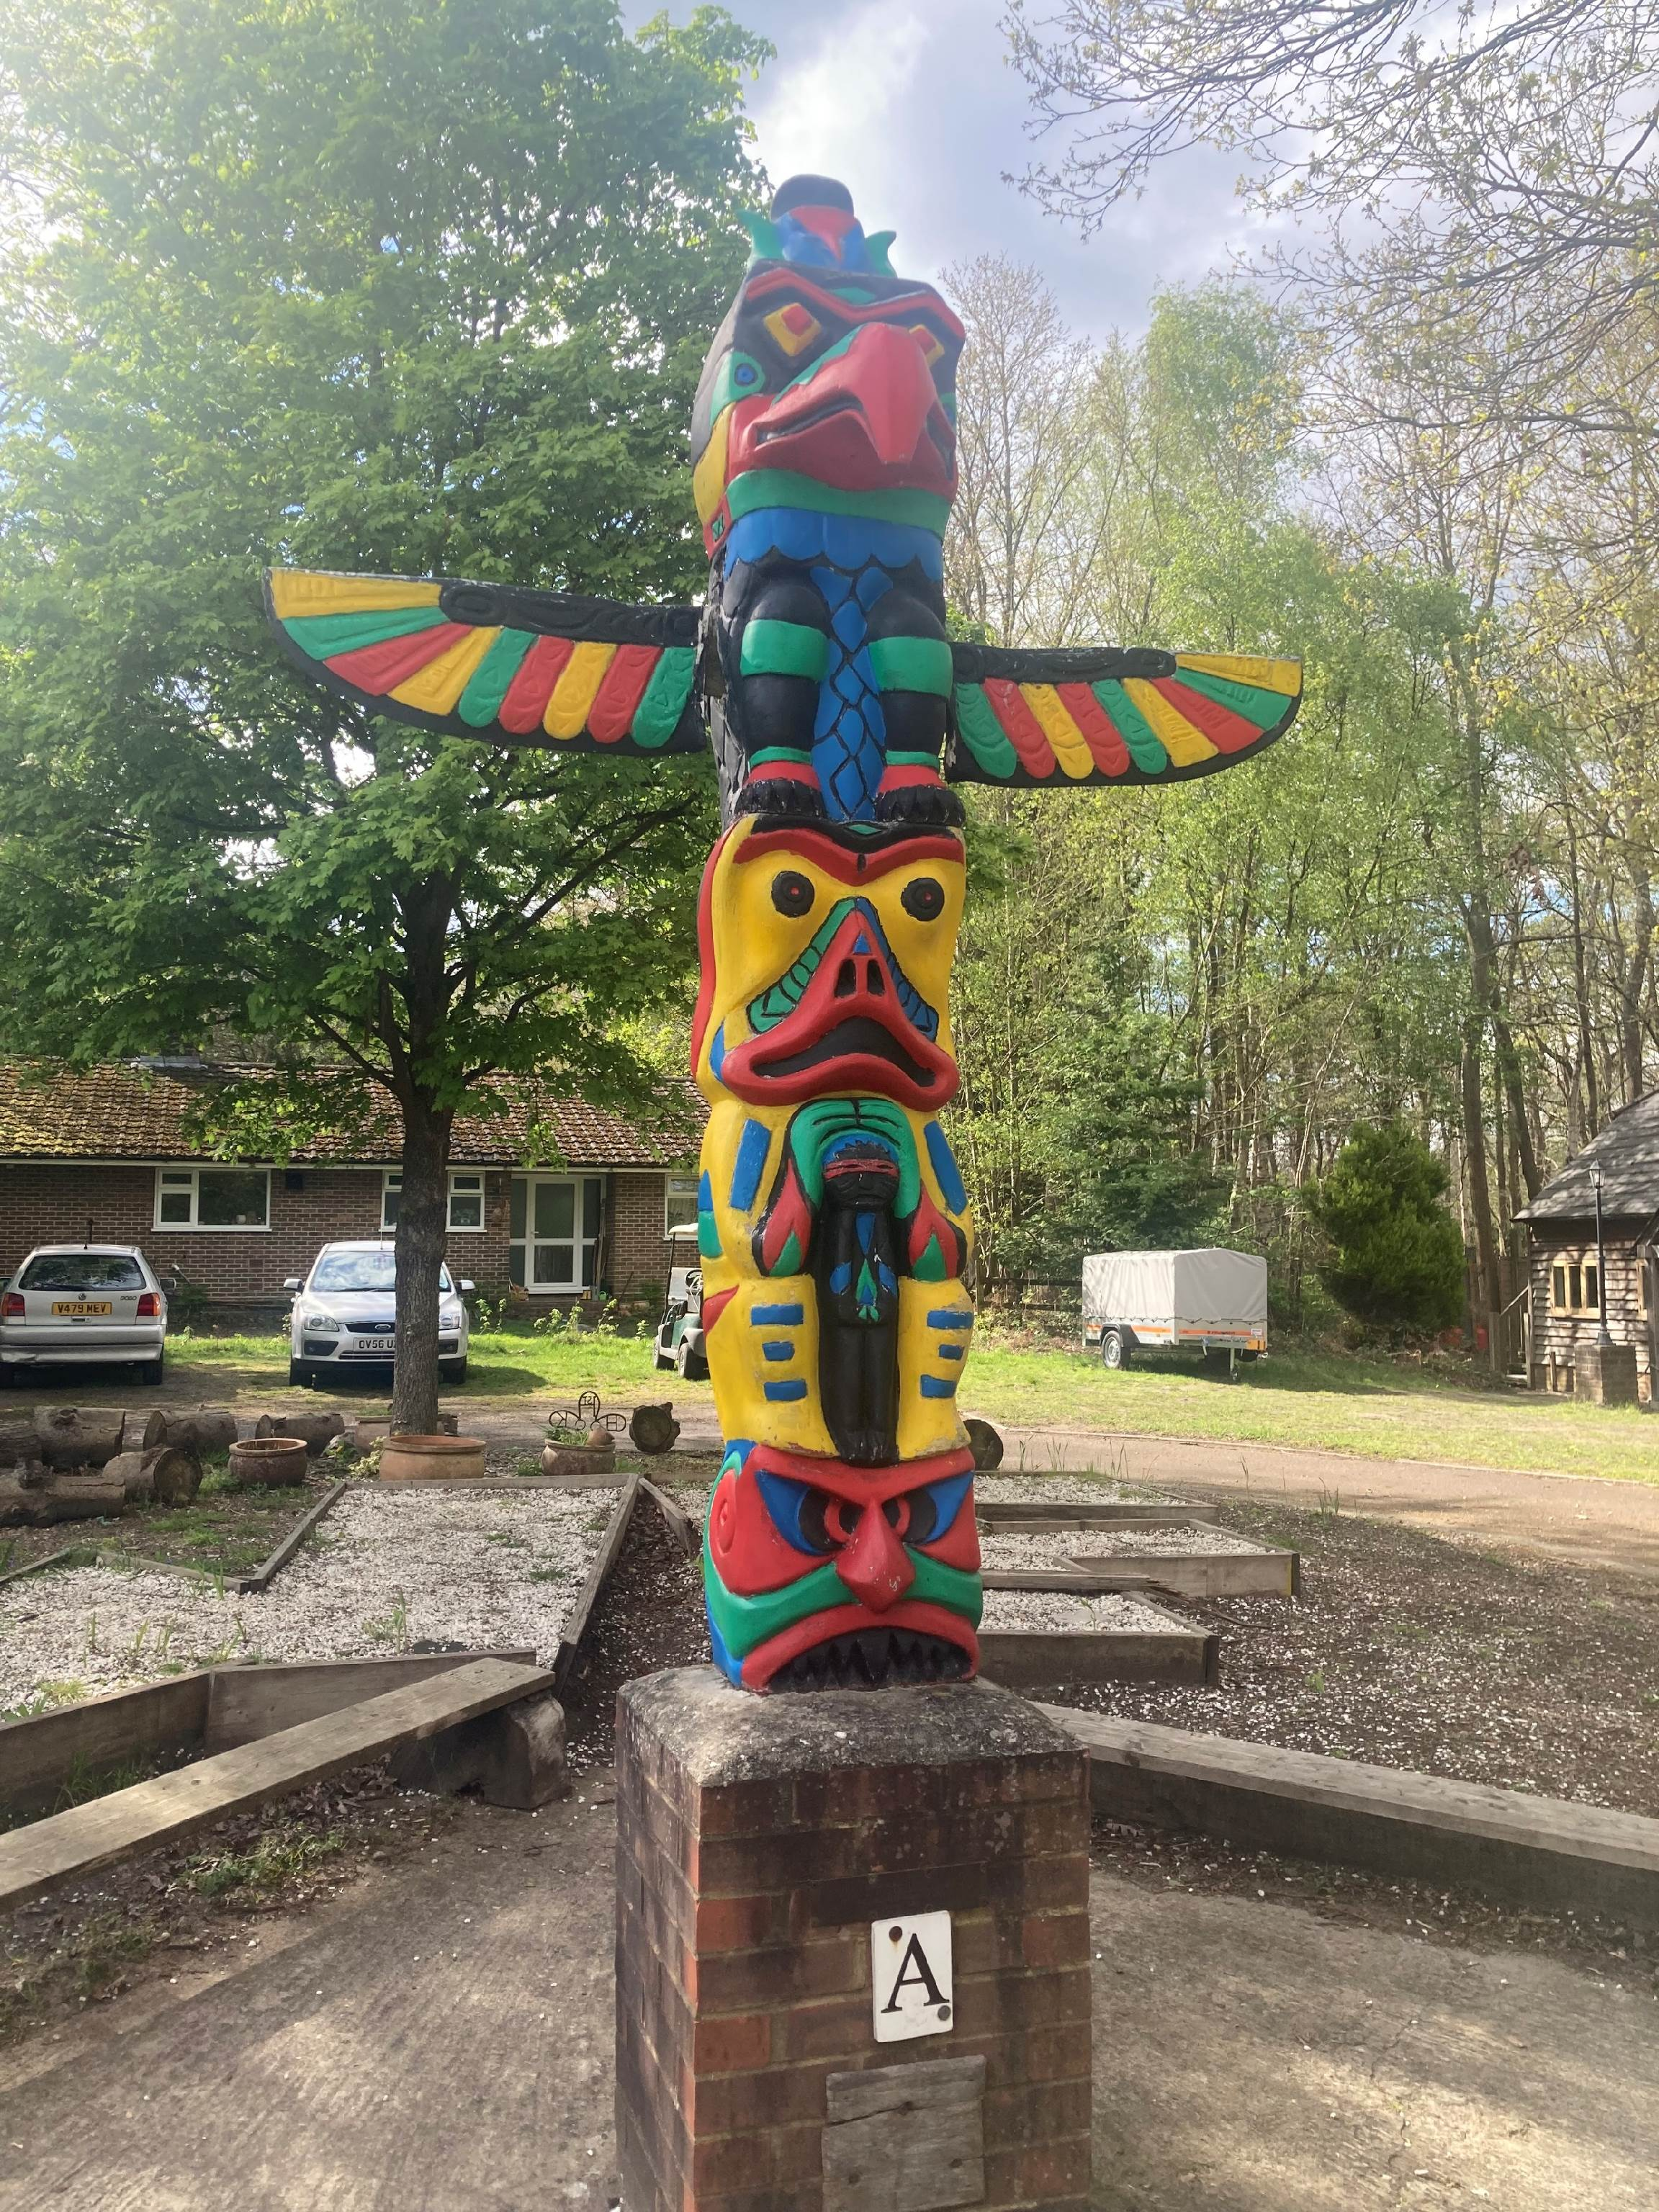
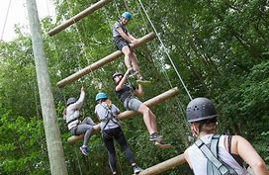
Year 6 Walton Firs Visit 20th – 23rd May 2025

Slide 2
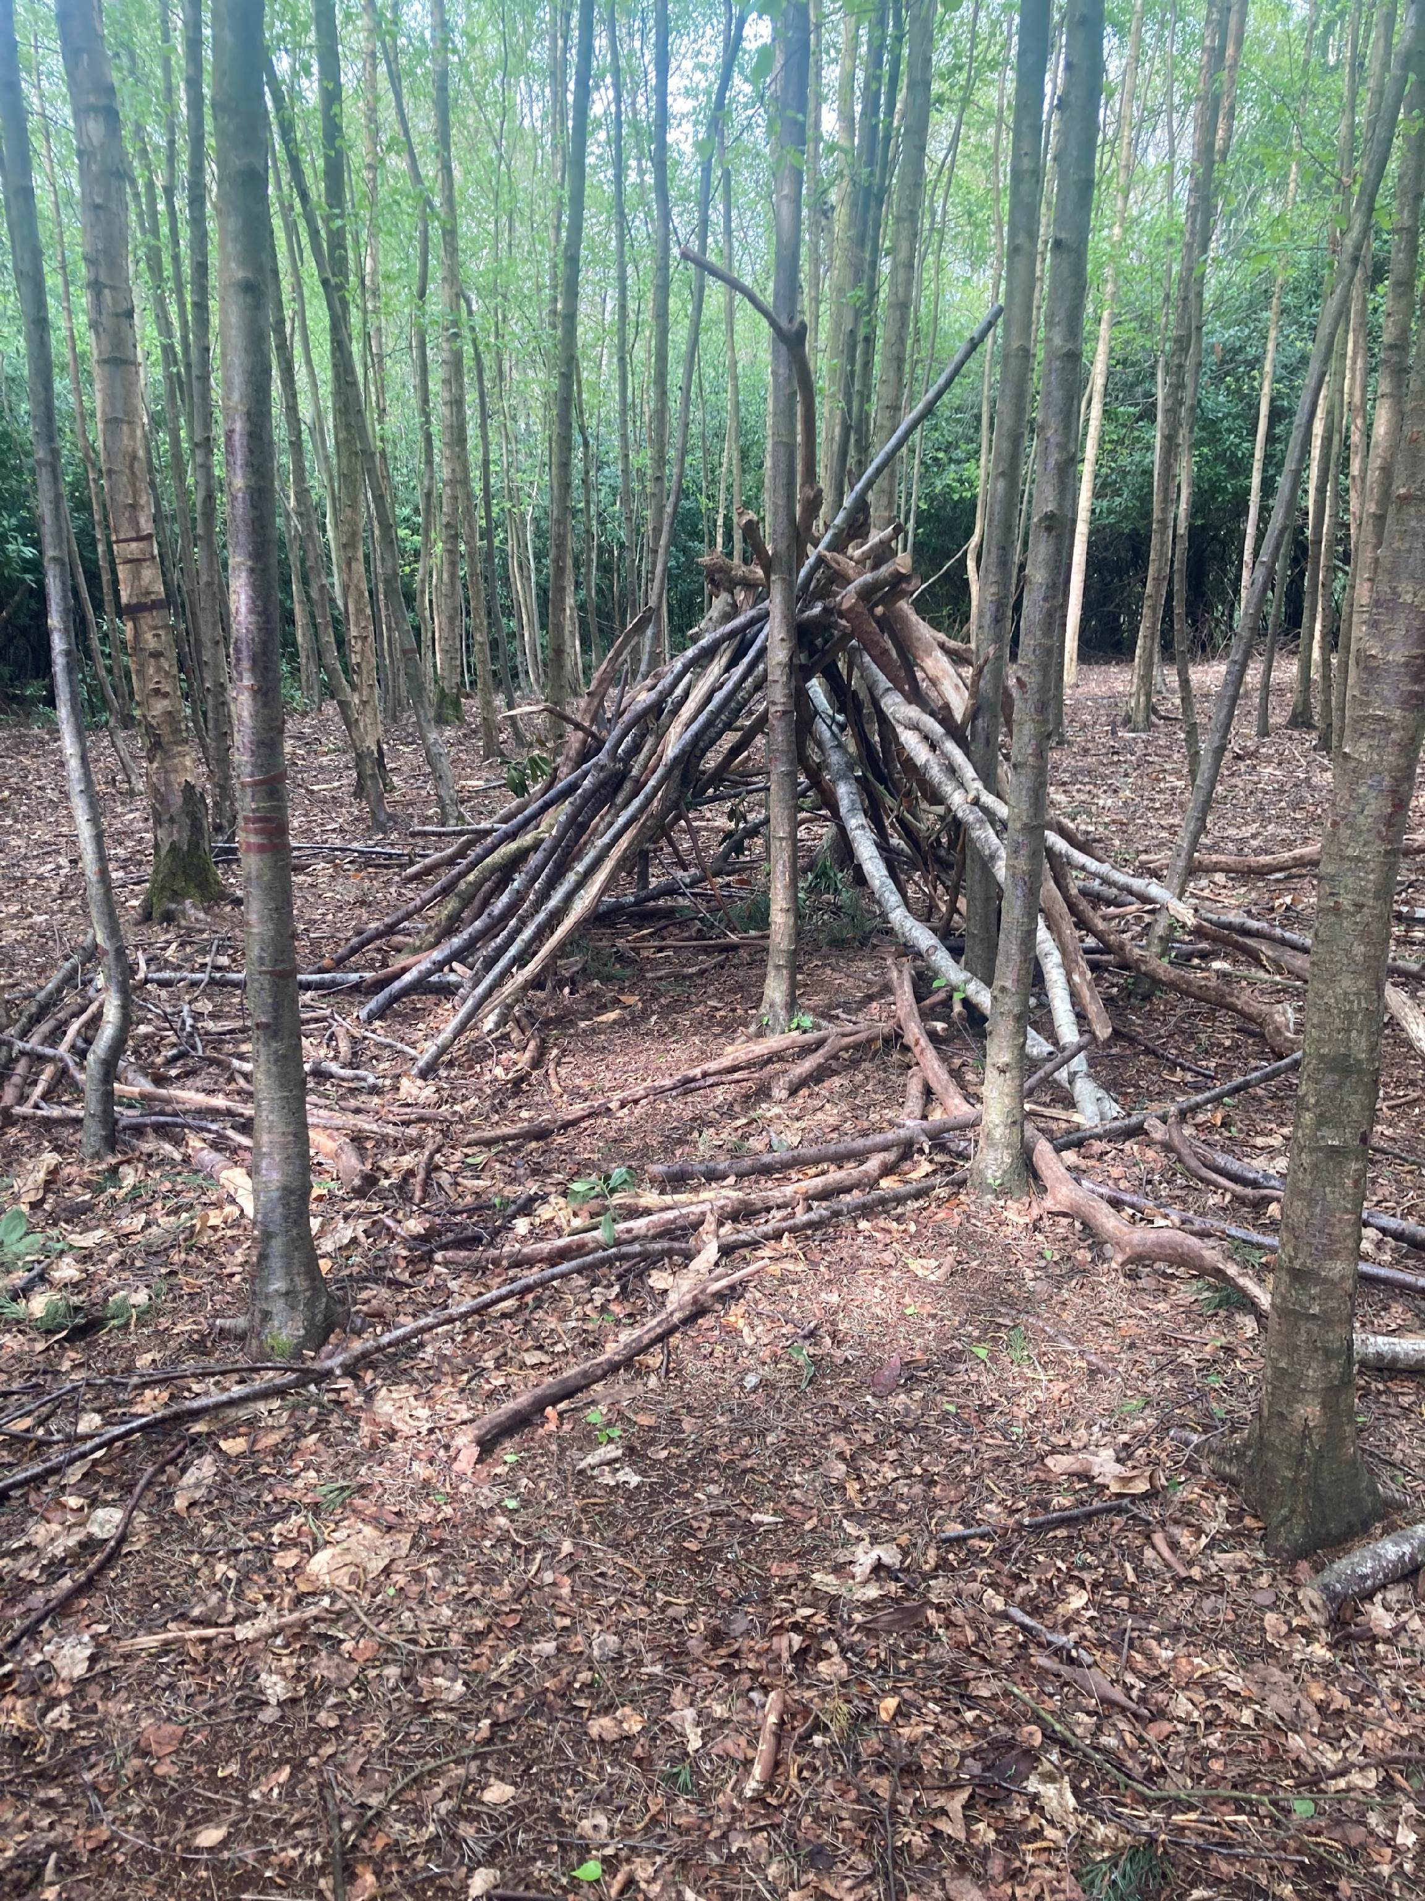
Members of staff
Mrs Bunch
Mrs Hudson
Mrs Andrews

Slide 3
Before we go........
Consent form needs to be completed
Pink Medical/Calpol / Paracetamol consent form to be completed;
Blue Photographs consent form to be completed;
Any other relevant information to be passed on to Mrs Bunch (Y6) or Mrs Griffin in the office

Slide 4
Site Map

Slide 5
Accomodation

Slide 6
Accomodation

Slide 7
Room arrangements
Bedrooms can sleep up to 6 children.
Boys and girls will be in separate bedrooms with staff members along the corridor.
Bedroom/friendship allocations will be worked out beforehand and notified upon arrival.
There are main shower blocks and toilets are a very short walk away. There is a night time toilet available.

Slide 8
Arrival at school
Tuesday 20th May
Pocket money arrangements – £5-10 in coins to be given in a named envelope or wallet to the adult responsible for money collection on the day
Medicine – all medicine to be named and given to an adult responsible for medicines on the day of travel
Travel arrangements to Walton Firs – children to arrive at school no later than 10am; the coach will depart by 10:30am (exact time to be confirmed nearer the date).
(If dropping off early, let Mrs Bunch / Mrs Dodd know)

Slide 9
On arrival at Walton Firs
Pembroke Building
The room allocation…
Bed making…
The fire bell….
The activity groups... (2 groups)
Eat packed lunch (brought from home / ordered from Caterlink)

Slide 10
Daily routines
Wake up between 7:15am and 7:30am
Meal times:
- Breakfast 8am - 9am
- Lunch 1pm – 2pm
- Break 3:30pm – 4:00pm
- Dinner 6pm – 7pm
Daily room inspection after breakfast
Activities
Shop (times tbc)
Down time
- 8:30 – 9:30 – Hot chocolate, chat about the day, showers
- 9:30 – 10pm – settle in rooms and lights out at 10pm

Slide 11
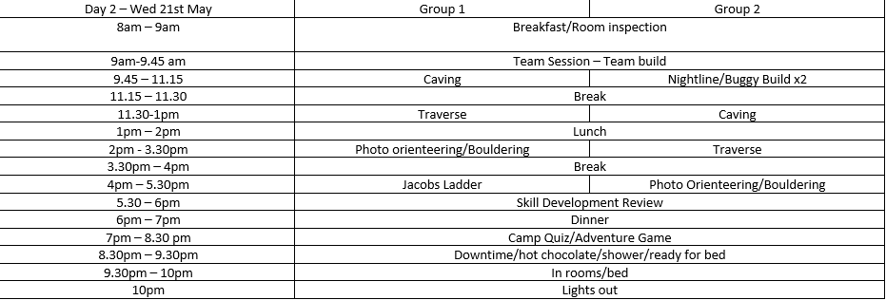
Activities

Slide 12
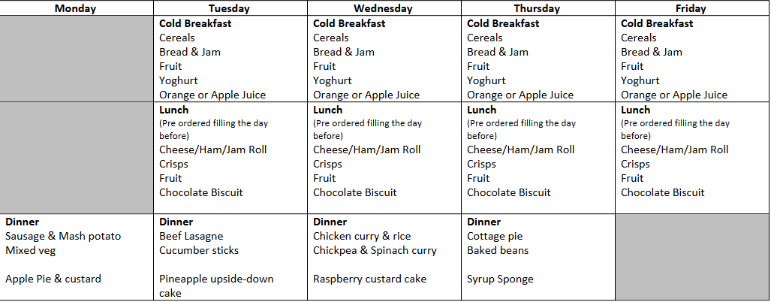
Sample Menu

Slide 13
Kit List
Essential:
Sleeping bag, pillow and pillowcase
Optional bottom sheet
Nightwear
Jacket (waterproof with a hood)
Sun hat and sun cream
Torch with spare batteries
Day rucksack with a named water bottle
Named bin liner for dirty clothes
Travel games, puzzle books, reading books, cards, notebook and pens etc for down time

Slide 14
Kit List
Old clothing better than a new wardrobe, preferably dark in colour
Layers of clothing – depending on weather!
Tracksuit bottoms, long socks, sweatshirts, long sleeved tops, t-shirts
A waterproof jacket & trousers
2 pairs of trainers OR 1 pair of walking boots plus trainers PLUS one pair of indoor shoes (slippers/crocs)
Spare socks!
Towel and toiletries
Plastic bags for dirty/muddy clothing
Lip balm!!!

Slide 15
No…
No aerosol deodorants, (the fire alarms are very sensitive!) take roll on deodorant instead
No mobile phones or electronic games
No food or sweets
If bringing digital cameras taken at own risk and responsibility, please label your camera clearly. They will not be allowed in bedrooms.
One small comfort item is allowed e.g. photo/teddy along with a book, playing cards, note-pad etc

Slide 16
In an emergency...
Contact Crockenhill school on 0300 065 8300 (school landline);
We will contact you directly if there are any problems;
Please do not try to contact your children directly.

Slide 17
Further information
A few daily photographs will be added to our class page on Class Dojo – dependent on the Wifi signal at Walton Firs! All other photos will be uploaded onto the school website when we return to school.
Pupils will return by coach to CROCKENHILL on the Friday 23rd May for approximately 3pm Traffic can be very busy – a text message will be sent if we are delayed
If another parent is collecting your child, please let Mrs Griffin at the office know in advance

Slide 18
Any questions?

