Slide 1

End of Key Stage Two Assessments 2026

Slide 2
What are the SATs?
SATs are the Standardised Assessment Tests that are given to children at the end of Key Stage 2.
The SATs take place over four days, starting on Monday 11th May ending on Thursday 14th May.
The SATs papers consist of:
  Grammar, punctuation and spelling (paper 1: GPS) – Monday 11th May
  Grammar, punctuation and spelling (paper 2: Spelling) – Monday 11th May
  Reading – Tuesday 12th May
  Maths (paper 1: Arithmetic) – Wednesday 13th May
  Maths (paper 2: Reasoning) – Wednesday 13th May
  Maths (paper 3: Reasoning) – Thursday 14th May
Writing is assessed using evidence collected throughout Year 6. There is no Year 6 SATs writing test.
The key stage 2 tests will be taken on set dates unless your child is absent, in which case they may be able to take them up to 5 school days afterwards.

Slide 3
When and how the SATs are completed
The tests take place during normal school hours, under exam conditions.
Children are not allowed to talk to each other from the moment the assessments are handed out until they are collected at the end of the test.
After the tests are completed, the papers are sent away to be marked externally.
The results are then sent to the school in July.
Each test lasts no longer than 60 minutes:
  Spelling, punctuation and grammar (paper 1: Grammar/ Punctuation) – 45 minutes
  Spelling, punctuation and grammar (paper 2: Spelling) – 15 minutes
  Reading – 60 minutes
  Maths (paper 1: Arithmetic) – 30 minutes
  Maths (paper 2: Reasoning) – 40 minutes
  Maths (paper 3: Reasoning) – 40 minutes

Slide 4
The results
Tests are marked externally. Once marked, the tests will be given the following scores:
A raw score (total number of marks achieved for each paper);
A scaled score (see below);
A judgement on if the National Standard has been met.
After marking each test, the external marker will convert the raw score to a scaled score. Even though the tests are made to the same standard each year, the questions must be different. This means the difficulty of the tests may vary. Scaled scores ensures an accurate comparison of performance over time.
Scaled scores range from 80 to 120.
A scaled score of 100 or more shows the pupil is meeting the National Standard.
Notes:
There is no separate test that would indicate a pupil is working above the national standard.
A scaled score of less than 99 would indicate a pupil is working below the national standard.
To have a scaled score, pupils must have a minimum raw score (determined each year). If the pupil does not achieve the minimum raw score, they have not demonstrated sufficient understanding of the KS2 curriculum in the subject.

Slide 5
Grammar, Punctuation and Spelling: Monday 11th May
Grammar, punctuation and spelling consists of two papers.
Paper 1 focuses on all three elements (grammar, punctuation and spelling or GPS). The paper lasts for 45 minutes.
Paper 2 consists of a spelling test only. It should take approximately 15 minutes, although this is not a set amount of time (pupils should be given as much time as they need to complete the test).

Slide 6
Grammar, Punctuation and Spelling: Paper 1 (GPS)
The children will have been working hard with their class teacher on developing and securing their knowledge of the technical vocabulary needed in this test.
This test focuses on:
Grammatical terms/ word classes;
Functions of sentences;
Combining words, phrases and clauses;
Verb forms, tenses and consistency;
Punctuation;
Vocabulary;
Standard English and formality.
This test requires a range of answer types but does not require longer formal answers.
Notes:
The question types include:
Circling
Drawing lines to connect
Multiple choice questions (including ticking tables)
One-word answers
Short answer questions

Slide 7
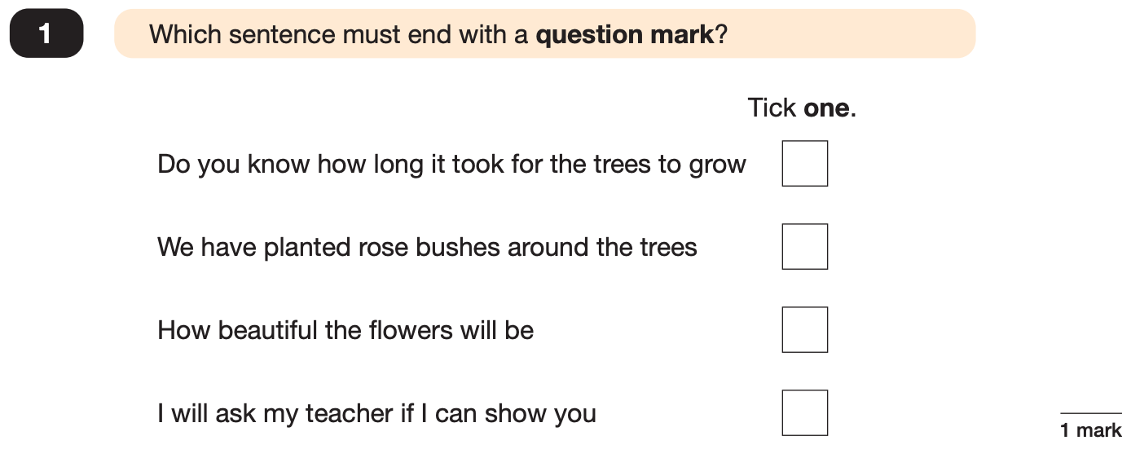
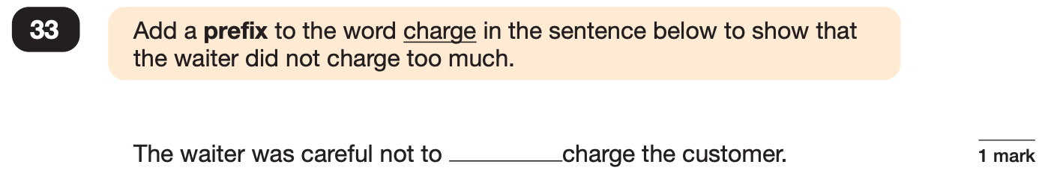
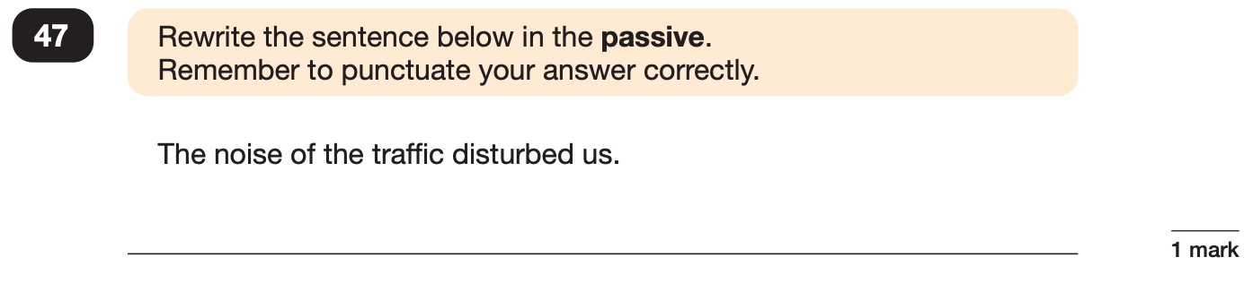
Grammar, Punctuation and Spelling: Paper 1 (GPS)
Example questions:
✓
over
e.g. We were disturbed by the noise of the traffic.
Notes:
Questions are from the 2024 GPS SATs paper.
For question 47 the answer scheme details several correct answers and answers that should not be accepted (e.g. misspellings of verb forms or errors in punctuation or capitalisation.)

Slide 8
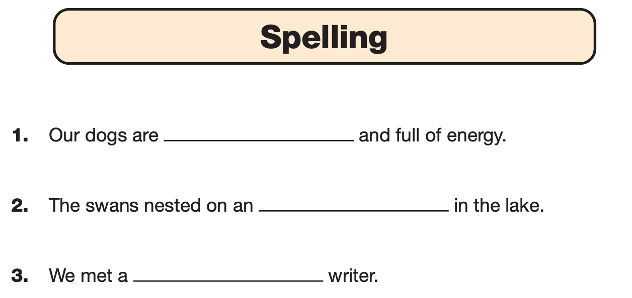
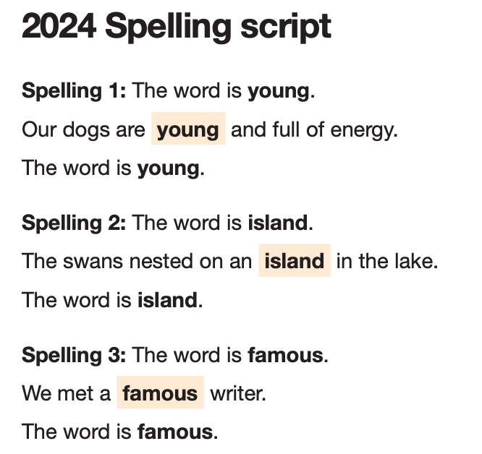
Grammar, Punctuation and Spelling: Paper 2 (spelling)
Paper 2 is a shorter paper that focuses solely on spellings.
Example questions:
Notes:
Questions are from the 2024 Spelling SATs paper.

Slide 9
Reading: Tuesday 12th May
There is one reading test that lasts for 60 minutes.
The test is designed to measure if the children’s comprehension of age-appropriate reading material meets the national standard. There are three different set texts for children to read. These could be any combination of non-fiction, fiction and/ or poetry.
The test covers the following areas (known as Content Domains):
Give/ explain the meaning of words in context;
Retrieve and record information/ identify key details from fiction and non-fiction;
Summarise main ideas from more than one paragraph;
Make inferences from the text/ explain and justify inferences with evidence from the text;
Predict what might happen from details stated and implied;
Identify/ explain how information/ narrative content is related and contributes to meaning as a whole;
Identify/ explain how meaning is enhanced through choice of words and phrases;
Make comparisons within the text.

Slide 10
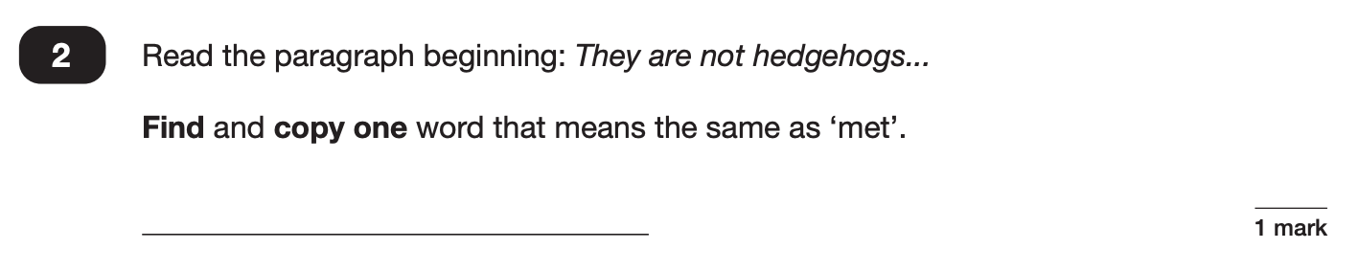
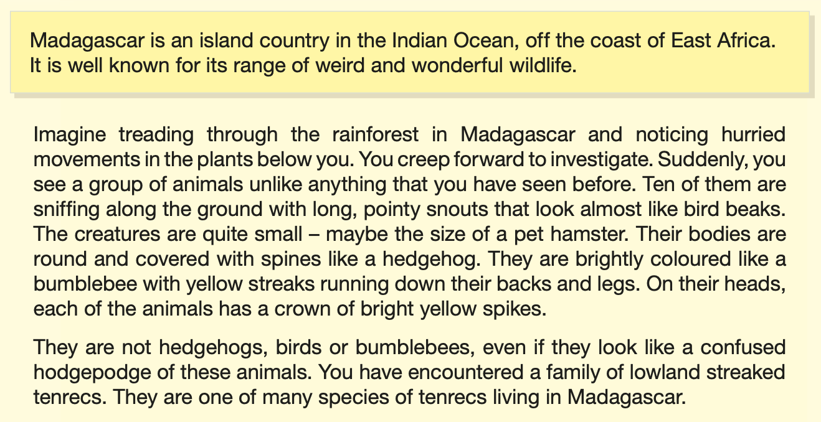
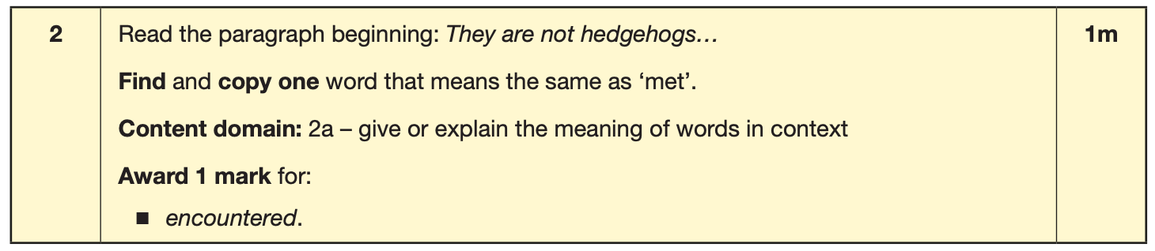
Reading
The reading SATs paper requires a range of answer styles.
Example questions:
Notes:
Questions are from the 2024 Reading SATs paper.
Question styles include:
Multiple choice questions
One-word answers
Short answer questions
Multiple mark (long answer) questions

Slide 11
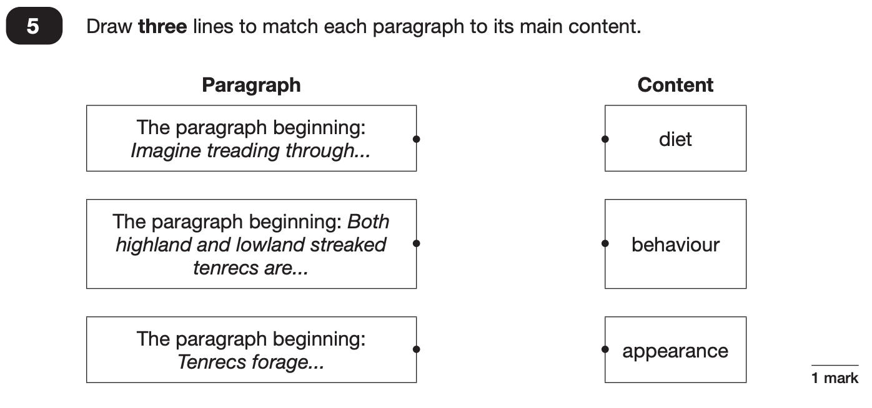
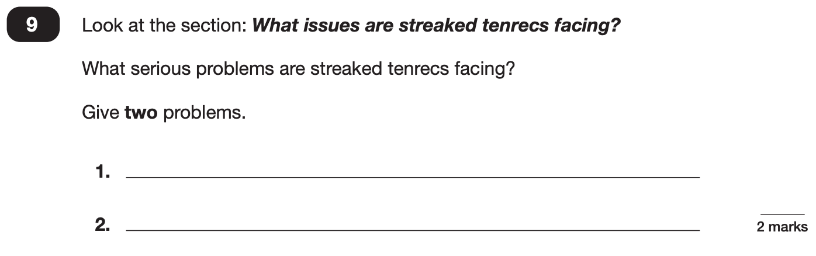
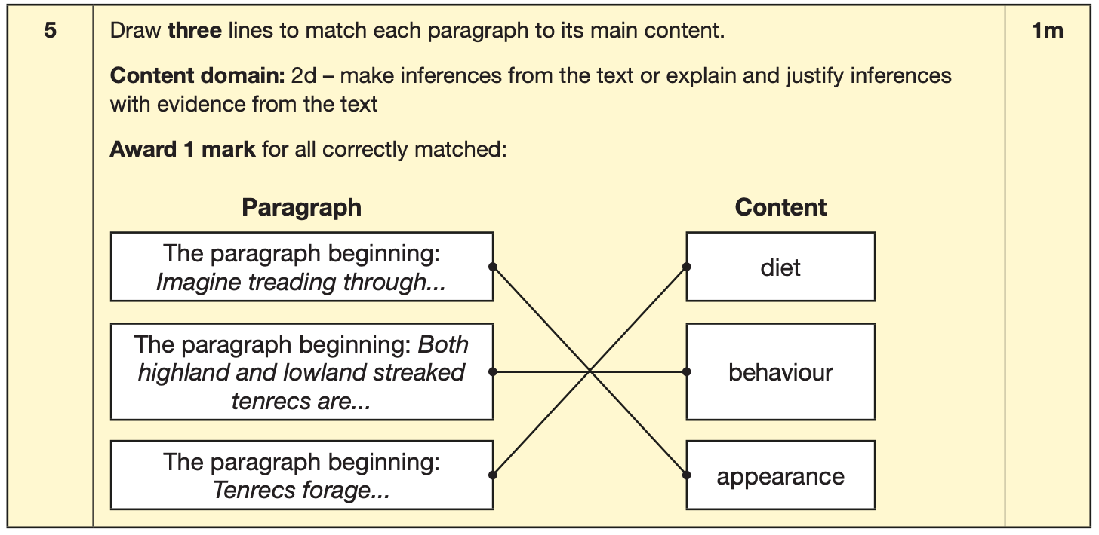
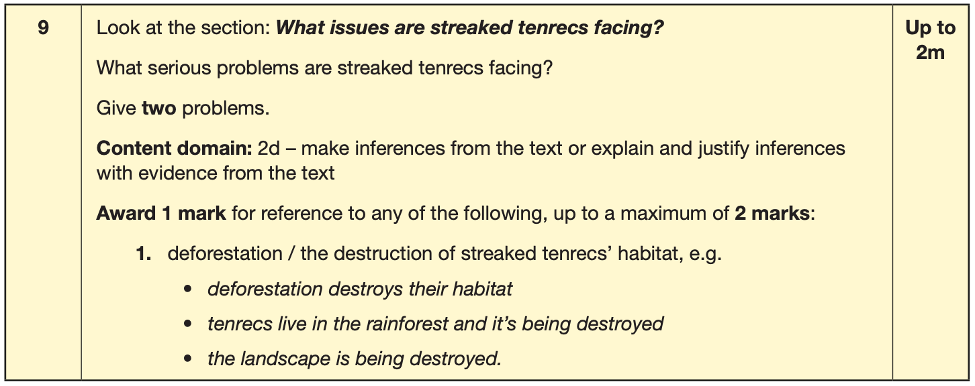
Reading
Example questions:
Notes:
Questions are from the 2024 Reading SATs paper.

Slide 12
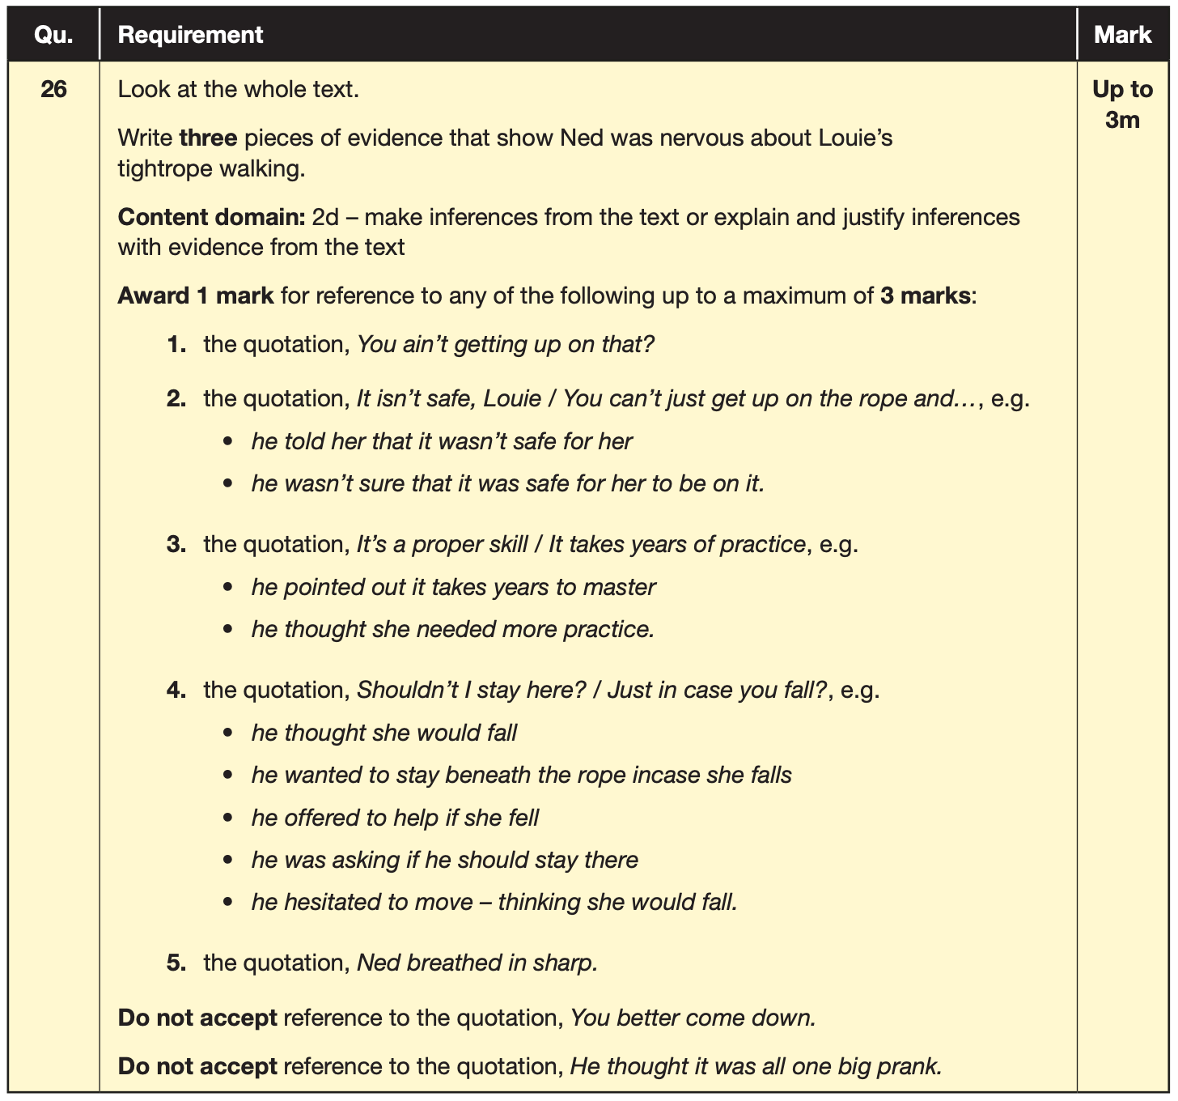
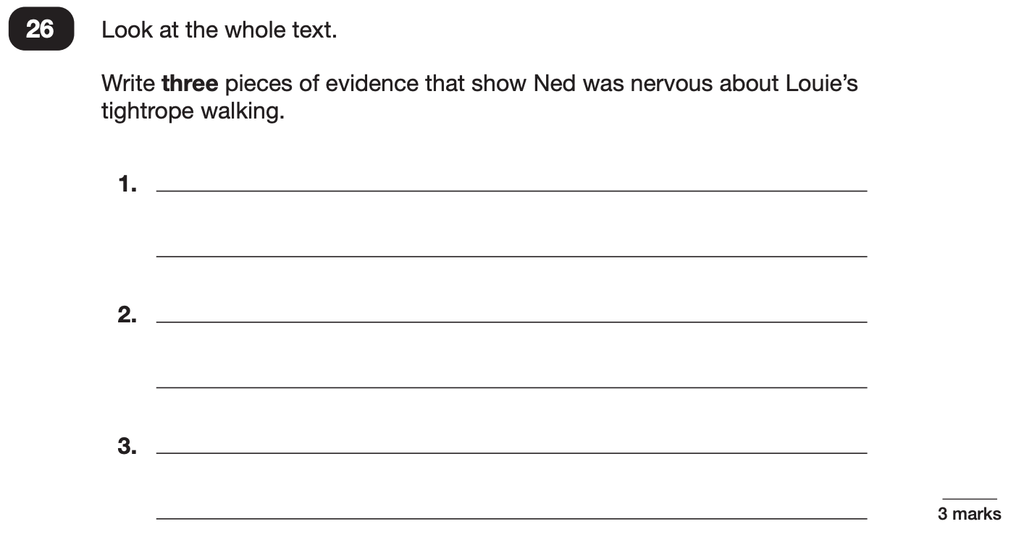
Reading
Example questions:
3 mark question
Notes:
Questions are from the 2024 Reading SATs paper.

Slide 13
Reading
Since the current testing formation for the SATs began in 2016, there has been a tendency for three types of questions to be the most popular.
In the 2024 Reading SATs paper,
10% of marks could be gained from answering questions involving giving and explaining the meaning of words in context;
38% of marks could be gained from answering questions involving retrieving and recording information or identifying key details from a text;
44% of marks could be gained from answering questions involving making inferences from a text and justifying inferences with text evidence.
When reading with your child at home try focusing on these types of questions.
Notes:
2% of questions: summarising main ideas from more than one paragraph.
6% of questions: making comparisons within the text
Example questions to ask at home:
What does this word mean?
Which word in this paragraph is the closest in meaning to…?
What [character] doing when [event] happened?
True or false questions about a paragraph/ text.
Why do you [character] did [event]? Can you think of another reason?

Slide 14
Maths: Wednesday 13th May and Thursday 14th May
The maths assessments consist of three tests.
Paper 1: Arithmetic (30 minutes) – Wednesday 13th May
Paper 2: Reasoning (40 minutes) – Wednesday 13th May
Paper 3: Reasoning (40 minutes) – Thursday 14th May

Slide 15
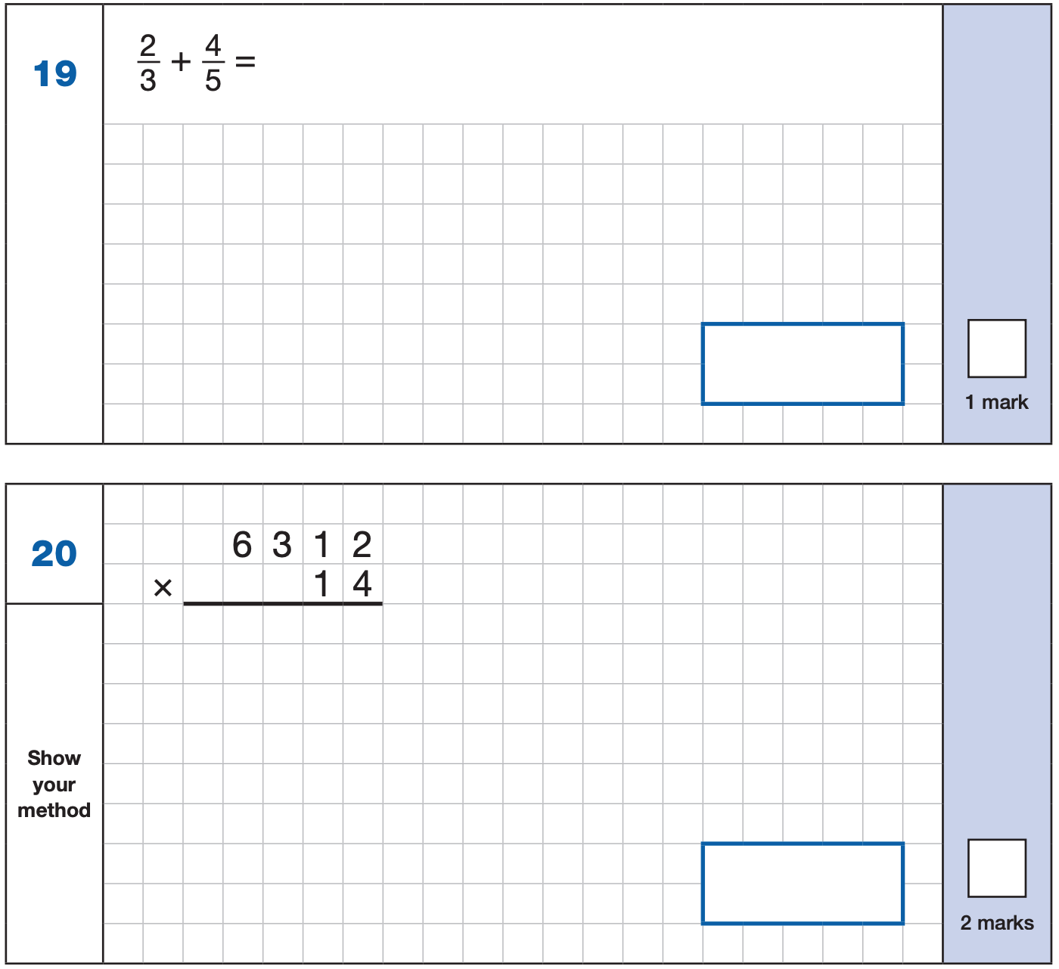
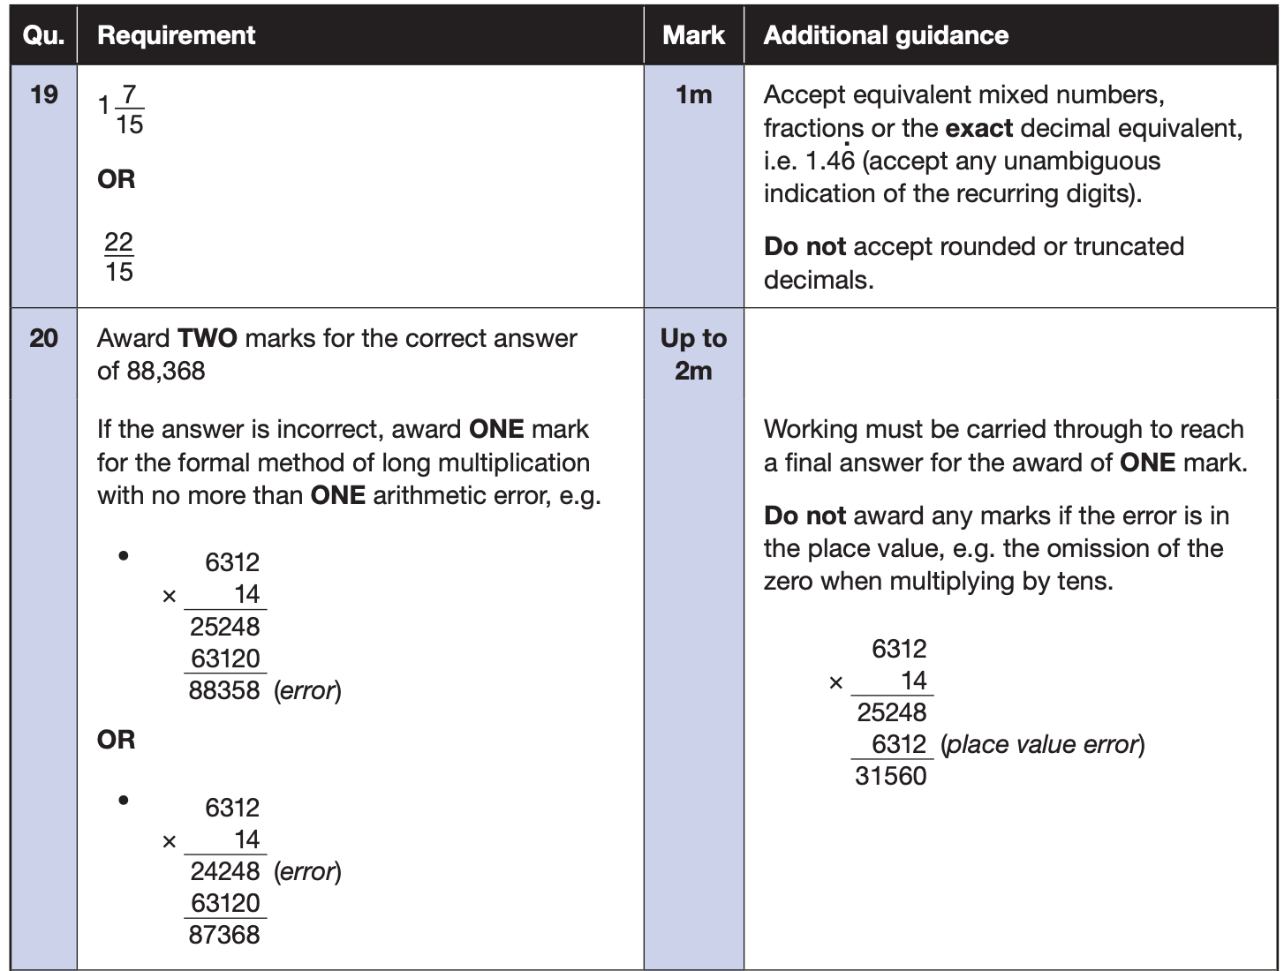
Maths Paper 1 (Arithmetic)
The maths arithmetic paper has a total of 40 marks and lasts for 30 minutes.
The test covers the four operations (addition, subtraction, multiplication, division, including order of operations requiring BIDMAS), percentages of amounts and calculating with decimals and fractions.
Example questions:
Notes:
Questions are from the 2024 Arithmetic SATs paper.
Identify that there are some questions that have 2 marks and some that have 1.

Slide 16
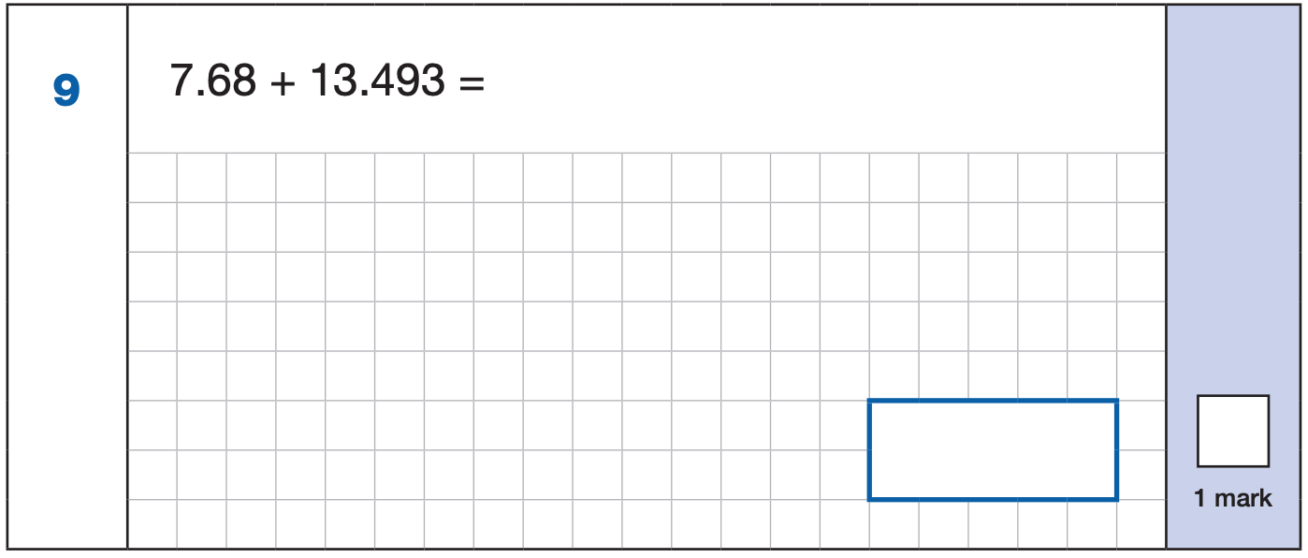
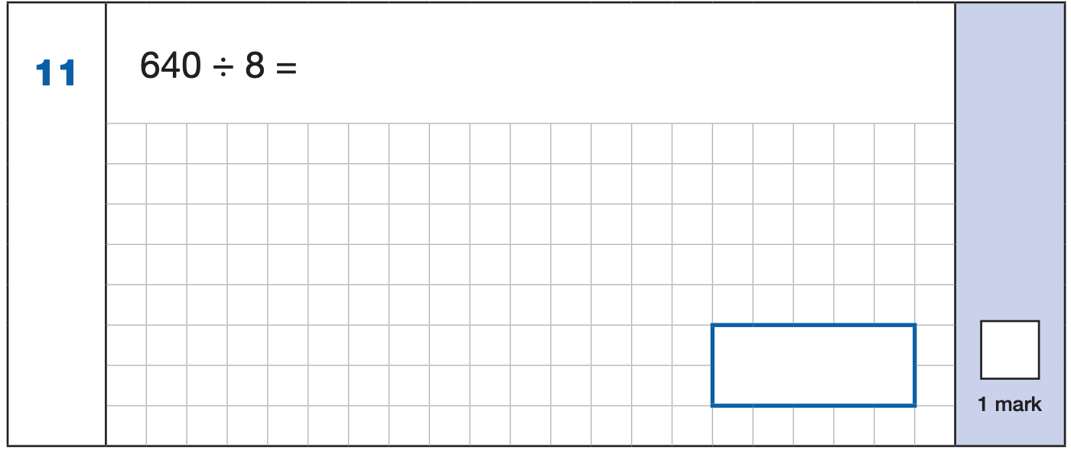
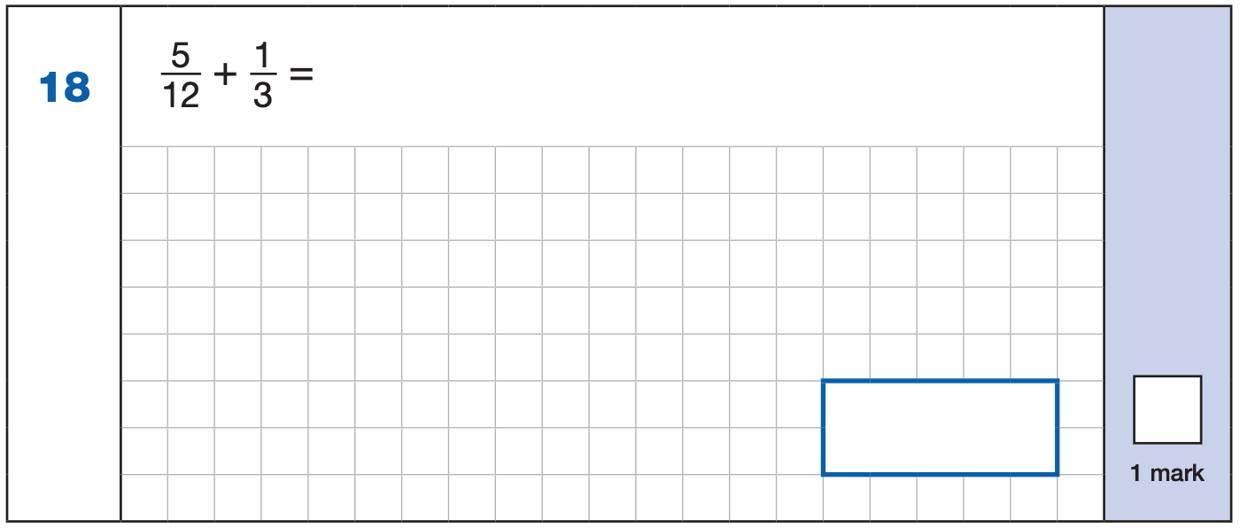
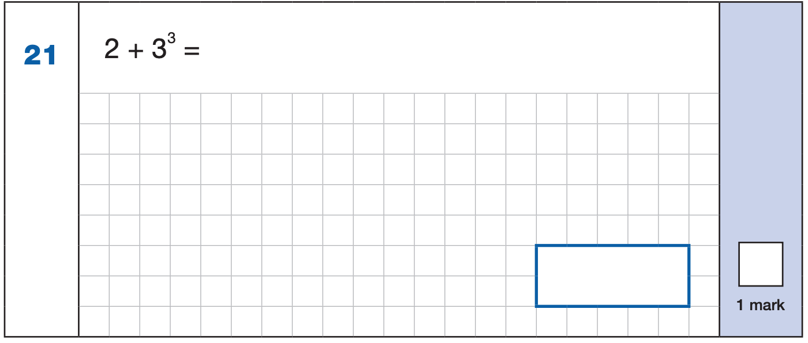


Maths Paper 1 (Arithmetic)
Example 1 mark questions:
7.680
+ 13.493.
21.173
¹ ¹ ¹
Mental method:
Using known fact of 64 ÷ 8 = 8
21.173
80
$\frac{\text{1}}{\text{3}}$ = $\frac{\text{4}}{\text{12}}$
$\frac{\text{5}}{\text{12}}$ + $\frac{\text{4}}{\text{12}}$ = $\frac{\text{9}}{\text{1}\text{2}}$
3³ = 27
2 + 27 = 29
$$\frac{\text{9}}{\text{1}\text{2}}$$
29
Notes:
Questions are from the 2024 Arithmetic SATs paper.
These are examples of how children could solve the calculations. There are some that could/ should be solved mentally as it is far quicker that way (40 marks in 30 minutes does not allow for 1 minute + per mark).
Answers should always be given in their simplest form unless stated otherwise.
Note that for question 18, equivalent fractions e.g. ¾ are accepted.

Slide 17
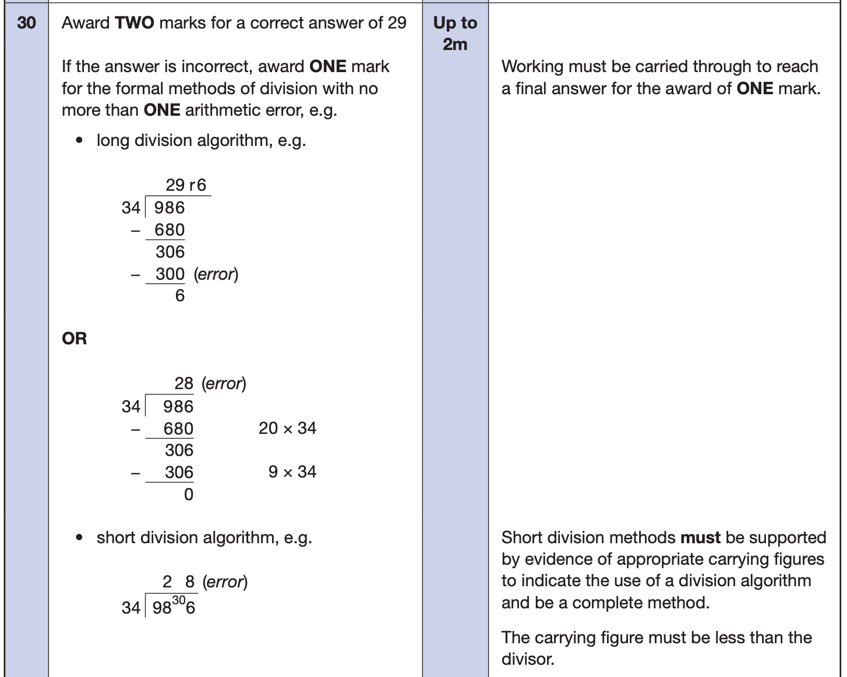
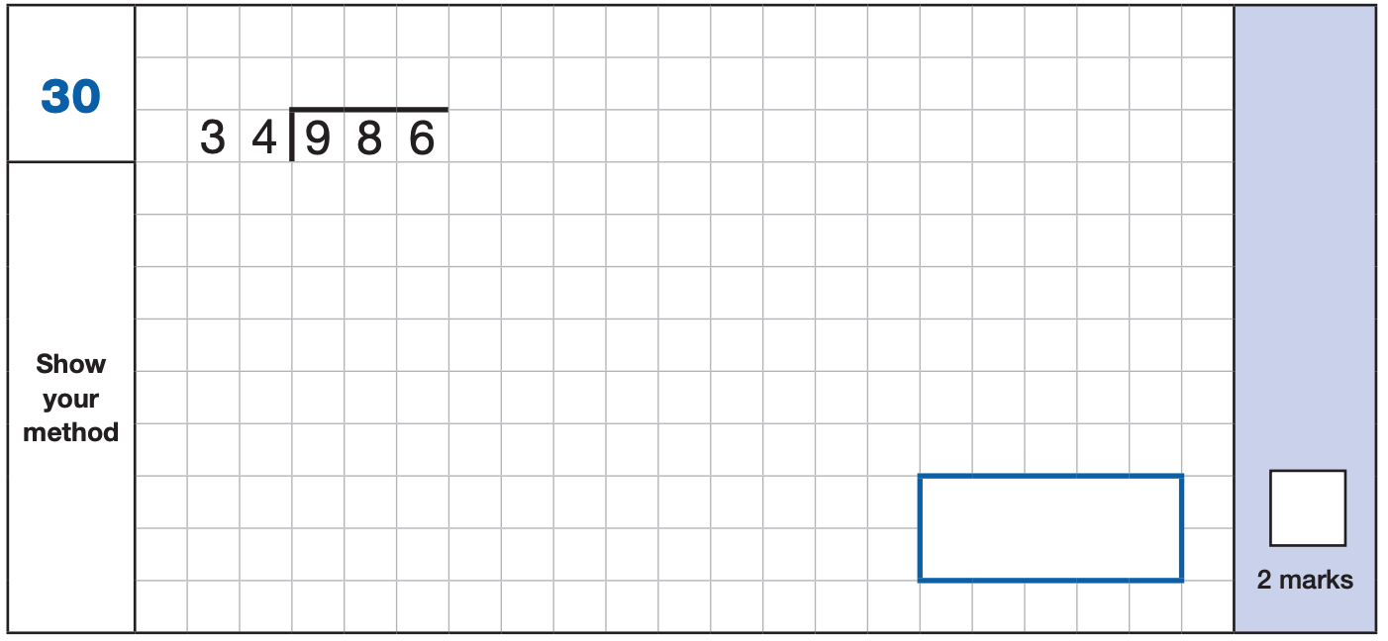
Maths Paper 1 (Arithmetic)
Example 2 mark question:
Notes:
Questions are from the 2024 Arithmetic SATs paper.

Slide 18
Maths Papers 2 and 3 (Reasoning)
Paper 2 will take place on Wednesday 13th May and paper 3 will take place on Thursday 14th May. These tests have a total of 35 marks each and lasts for 40 minutes each.
These papers require children to demonstrate their mathematical knowledge and skills, as well as their ability to solve problems and their mathematical reasoning. They cover a wide range of mathematical topics from key stage 2 including,
Number and place value (including Roman numerals);
The four operations;
Geometry (properties of shape, position and direction);
Statistics;
Measurement (length, perimeter, mass, volume, time, money);
Algebra;
Ratio and proportion;
Fractions, decimals and percentages.
Notes:
In general, the questions get progressively harder throughout the paper. As this is the case, it is not unusual for children to be unable to complete the entire paper in the given time.

Slide 19
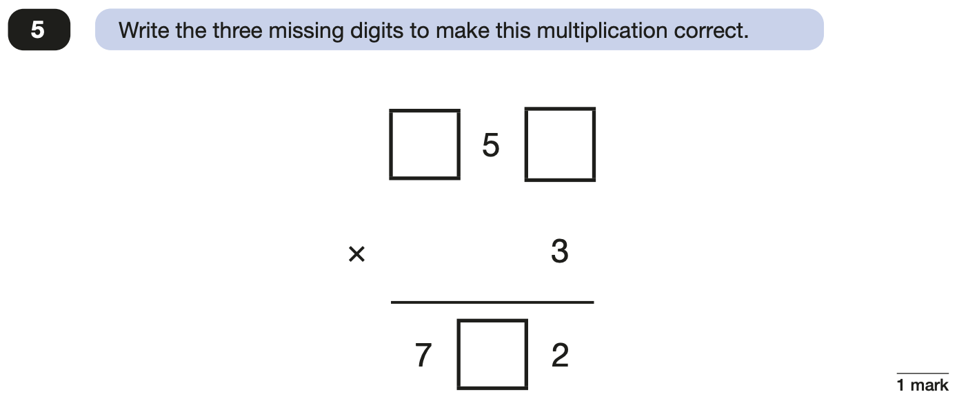
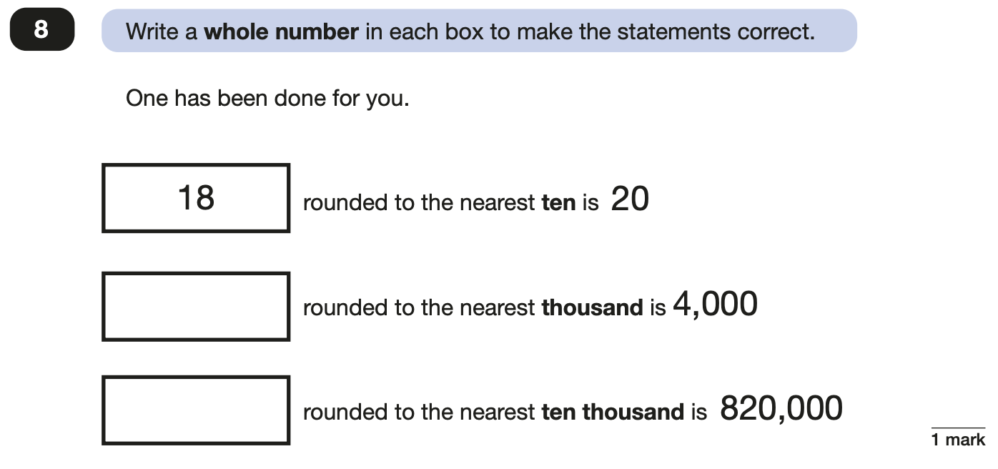
Maths Papers 2 (Reasoning)
Example questions:
2
4
3,500 to 4,499
6
815,000 to 824,999
Notes:
Questions are from the 2024 paper 2 Reasoning SATs paper.

Slide 20
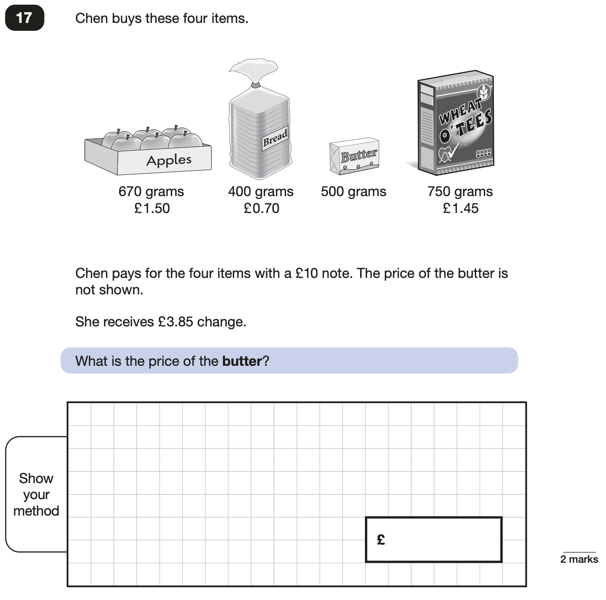
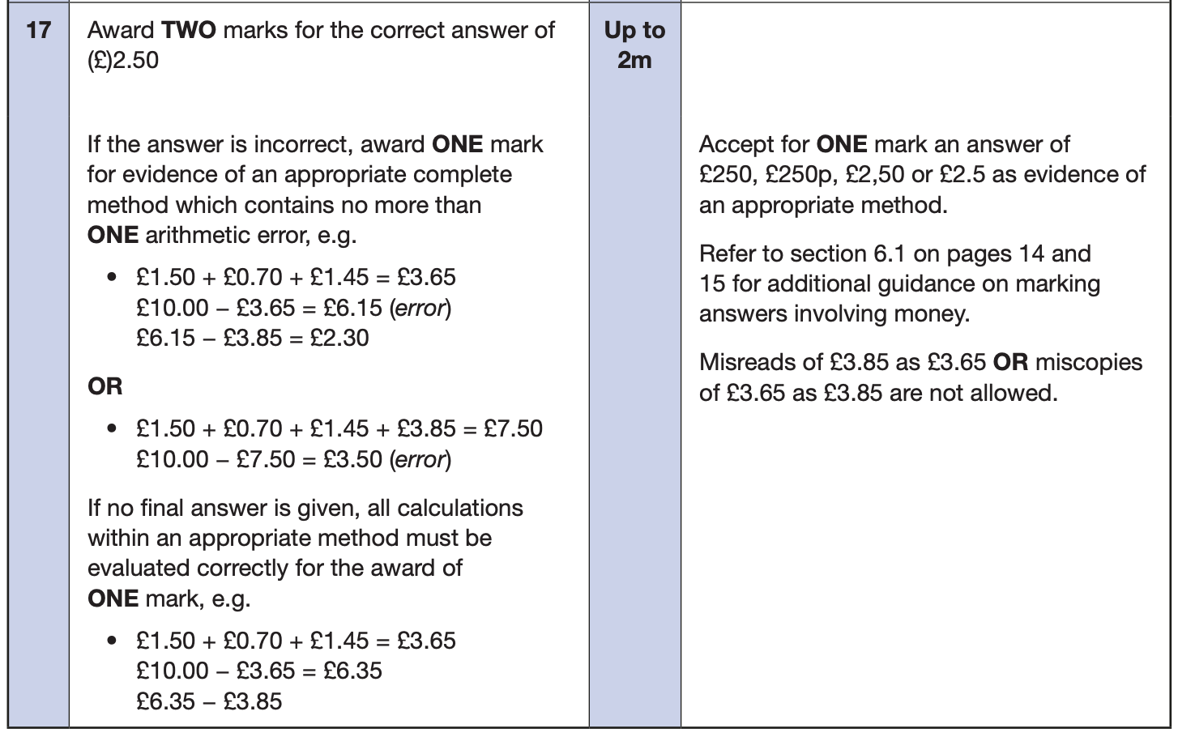
Maths Papers 2 (Reasoning)
Example questions:
Notes:
Questions are from the 2024 paper 2 Reasoning SATs paper.

Slide 21
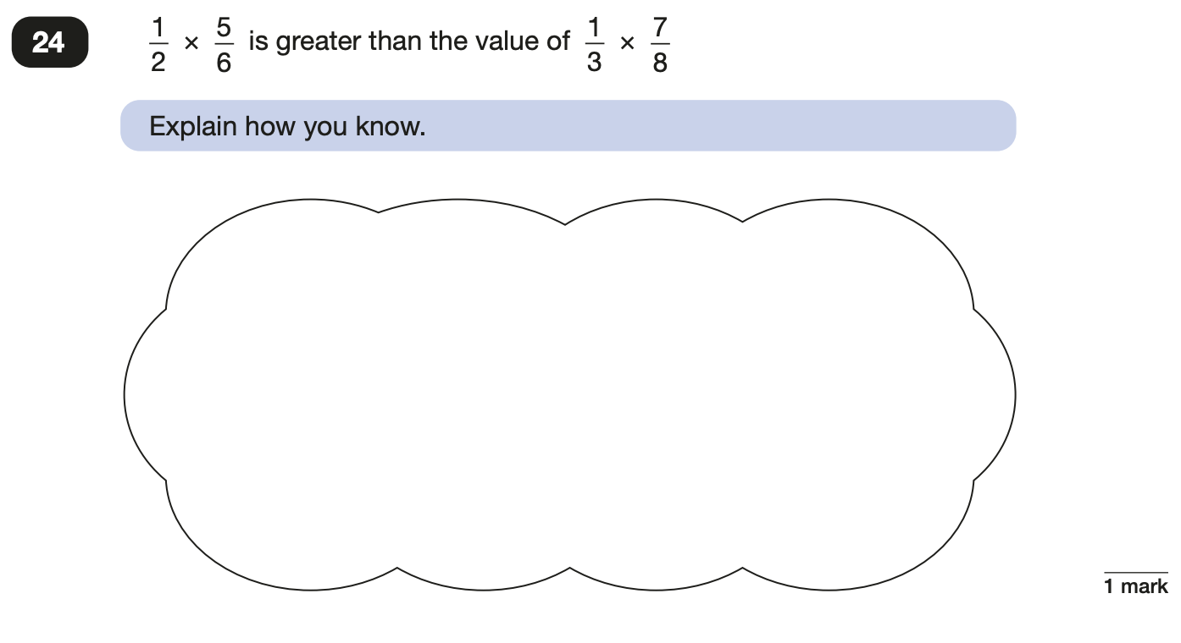
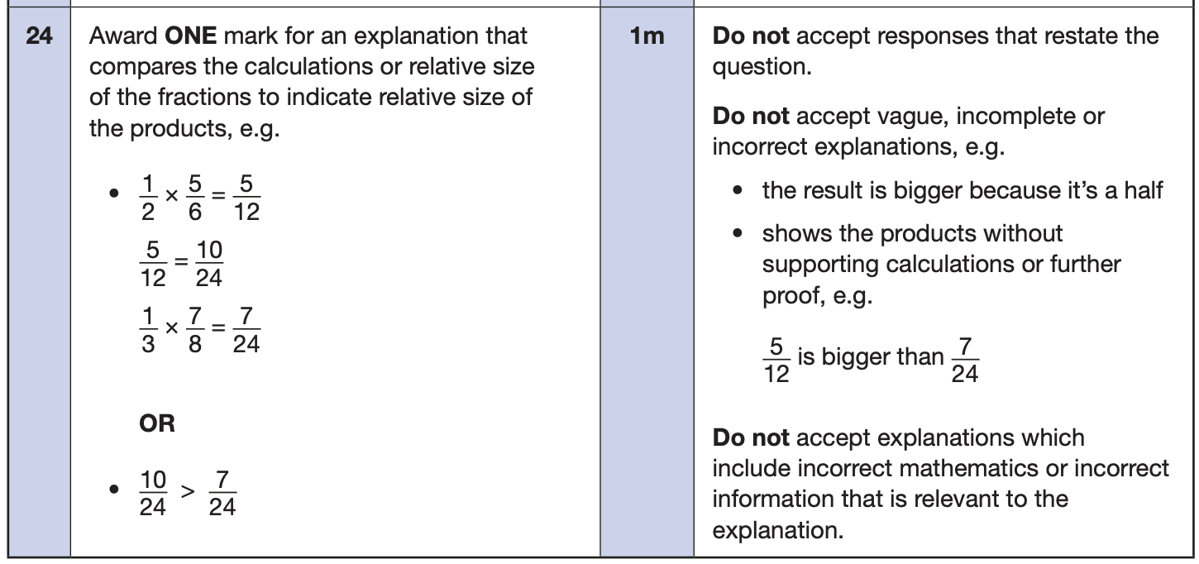
Maths Papers 3 (Reasoning)
Example questions:
Notes:
Questions are from the 2024 paper 3 Reasoning SATs paper.

Slide 22
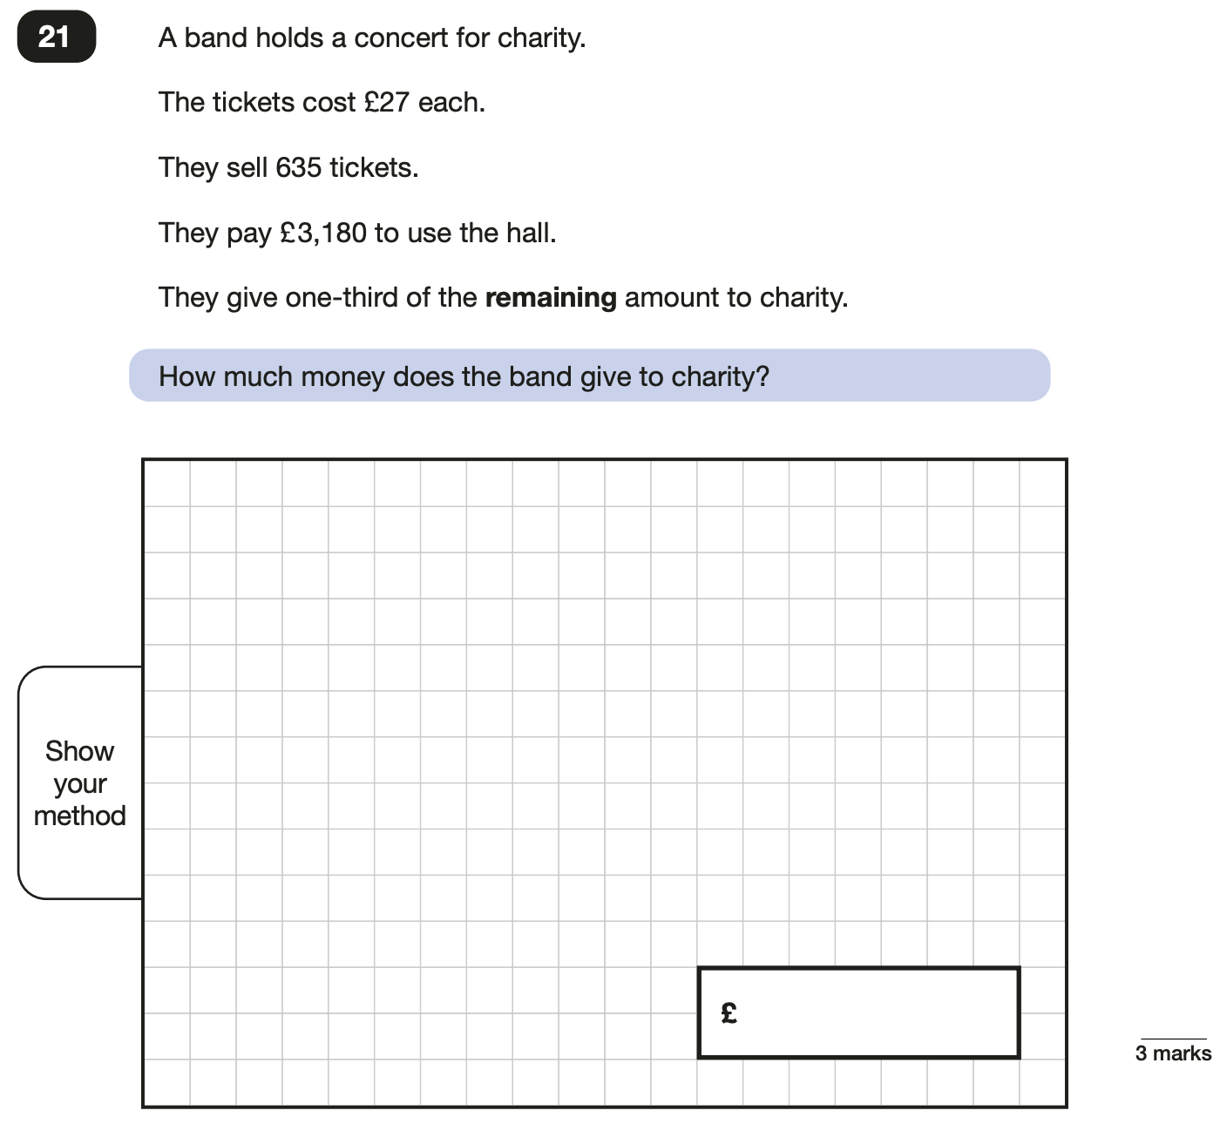
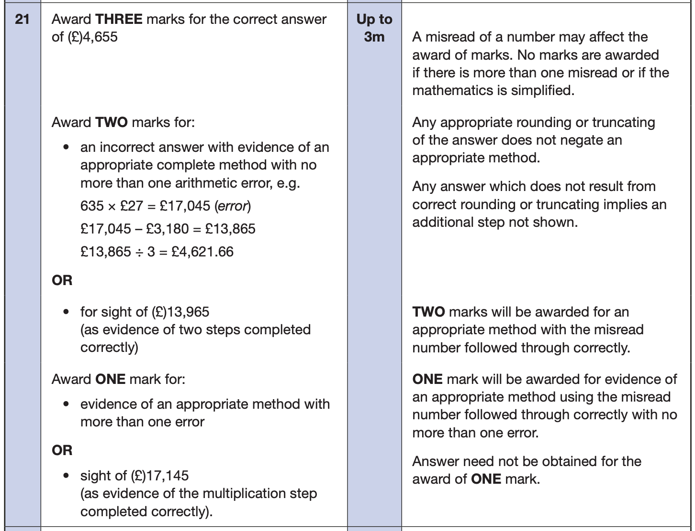
Maths Papers 3 (Reasoning)
Example question:
Notes:
Questions are from the 2024 paper 3 Reasoning SATs paper.
Note that this is a three mark question.

Slide 23
Supporting your child in preparing for the SATs
Firstly, a positive attitude goes a long way. Give them as much encouragement and support as you can (but we don’t need to tell you that)!
Tips:
Make sure they go to bed at a reasonable time, have a good breakfast and arrive at school on time during the assessment week.
We will be offering breakfast in school during the SATs week – cereal / toast served from 8:15am
Encourage them to try their best, commend their efforts and plan to celebrate their hard work at the end of the testing week, rather than focusing on the test results.
.
Notes:
Encourage parents not to use past papers at home. If they want to use past papers with tutors, suggest that they could take copies of completed test home to work through with tutors. This may help them to work through specific misunderstandings.

Slide 24
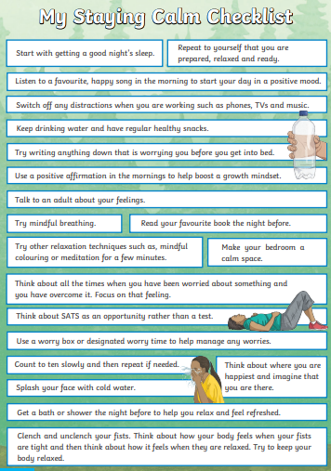

Slide 25
Things to remember about SATs
SATs focus on what children know about Maths and English.
They will not reflect how talented they are at science, geography, art, PE…, and they certainly won’t highlight all their amazing personal characteristics.
SATs don’t tell the whole story.
Their results will say if they did or did not meet a certain standard but not necessarily by what margin. These thresholds change each year according to the overall national performance, so what was classed as ‘meeting the expected standard’ this year might not be the same as last year.
SATs are only four days out of a whole Primary School career.
In reality, there's one or two papers each day that last 30 to 60 minutes.

Slide 26
Any Questions?
Contents

