Slide 1

Welcome to Year 6!
Meeting for Parents

Slide 2
Year 6
PE Days – Wednesday and Friday
Children should come in to school wearing the correct PE kit and earrings should not be worn for PE lessons
Spelling and times table tests will be on a Friday
Homework will be set every Thursday and is due on a Tuesday

Slide 3
Year 6
The children should read regularly at home and fill in their reading records, which should be in school every day
Please send in water bottles
Please name everything!

Slide 4
Year 6 – Key Dates
Secondary school applications – deadline 31st October 2025
Secondary school offer day – 2nd March 2026
KS2 SATs week – 11th – 14th May 2026
Y6 residential and production – details tbc

Slide 5
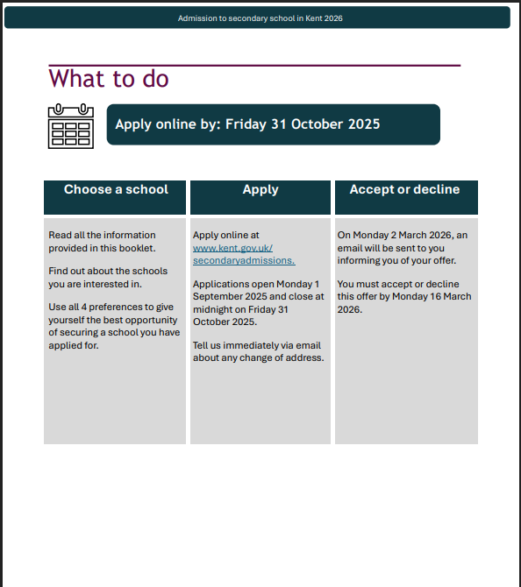
https://www.kent.gov.uk/education-and-children/schools/school-places/secondary-school-places

Slide 6
KS2 SAT tests 2026
The Tests
SATs tests will take place nationally in the week beginning
Monday May 11th – Thursday 14th May 2026
Statutory tests will be administered in the following subjects:
Reading (60 minutes)
Spelling (approximately 15 minutes)
Grammar and Punctuation (45 minutes)
Mathematics
- Paper 1: Arithmetic (30 minutes)
- Paper 2: Reasoning (40 minutes)
- Paper 3: Reasoning (40 minutes)
All tests are externally marked.
Writing will be ‘Teacher Assessed’ and will be moderated by Kent

Slide 7
Our Curriculum Overview
Creative Curriculum themes for the year:
Autumn 1– The Amazing Americas
Autumn 2 – WW2
Spring 1 – Mayans
Spring 2 - Let There Be Light
Summer - Circle of Life & Y6 Production (tbc)

Slide 8
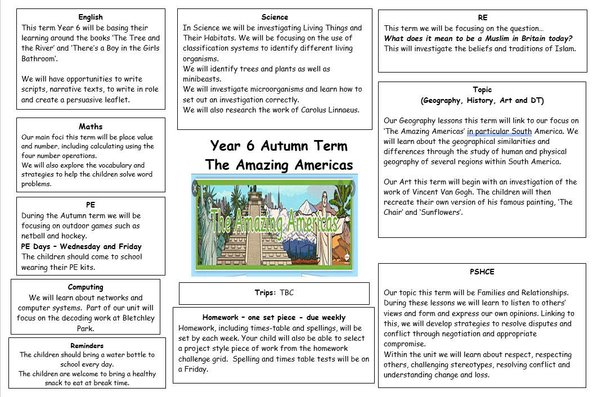
Our Curriculum Overview

Slide 9
Trips
Upcoming trips – dates to be confirmed:
Chislehurst Caves – History (WW2)
Rochester Cathedral – RE
As soon as we have confirmed details about the residential, we will let you know.

Slide 10
Maths:
We follow White Rose Maths progression for our maths lessons
The year is organised into blocks and each lesson within the block has a small step, which is the focus of the lesson
During the maths lessons, we practise fluency, reasoning and problem solving
We will also practise arithmetic and times tables during the week on top of our maths lessons.
Notes:
Show a workbook example

Slide 11
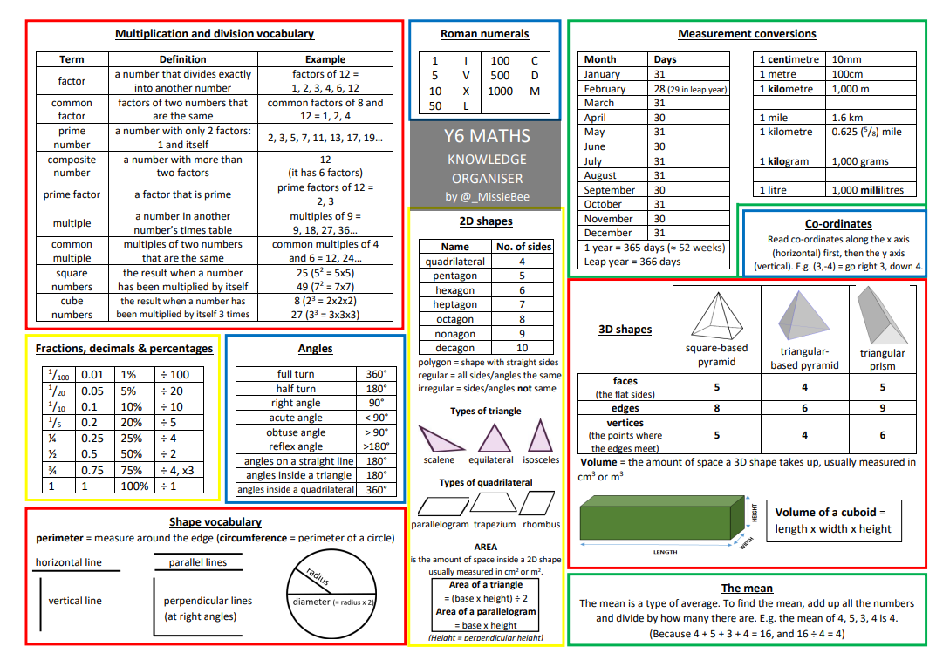
Maths:
Notes:
Show a workbook example

Slide 12
English:
The elements of English are reading, writing, GPS and speaking & listening
We develop reading skills through comprehension and whole class reading lessons based on a variety of extracts. We expect the children to read at home regularly.
Writing skills are taught in English lessons and throughout the curriculum. We base our English lessons on our core texts, which provide a stimulus for a variety of genres
Spelling rules and patterns are taught and tested weekly. Grammar and punctuation are taught through discrete grammar lessons and through writing lessons
Speaking and listening skills are developed in all areas of the curriculum.

Slide 13
Assessment Targets
Working Towards the expected standard;
Working At the expected standard;
Working Above the expected standard;
KS2 end of year assessment in reading, mathematics and GPS based on test attainment

Slide 14
KS2 SAT tests 2022- 23
Scaled Scores
Test scores will be reported as ‘scaled scores - What is meant by ‘scaled scores’?
It is planned that 100 will always represent the ‘national standard’.
Each pupil’s raw test score will therefore be converted into a score on the scale, either at, above or below 100.
The scale will have a lower end point somewhere below 100 and an upper end point above 100.
A child who achieves the ‘national standard’ (a score of 100) will be judged to have demonstrated sufficient knowledge in the areas assessed by the tests.
In July 2026 each pupil will receive:
A raw score (number of raw marks awarded).
A scaled score in each tested subject.
Confirmation of whether or not they attained the national standard

Slide 15
Our Challenge Values
Co-operation
Perseverance
Independence
Creativity
Motivation
Aspiration

Slide 16
Expectations
Uniform
Homework and spellings
Reading Books
P.E. Kit – our PE Days are Wednesday and Friday.

Slide 17
Communication
We will use Class Dojo to communicate anything related to the class and to share our learning.
You can message us on there but for absences etc please email the office email

Slide 18

Health and Wellbeing
6 ways to achieve wellbeing:
Be active
Keep learning
Give
Take Notice
Care
Connect

Slide 19
Thank you for coming to the
‘Welcome to the Year Group’ meeting for Year 6.
Any questions ?

